Slide 1

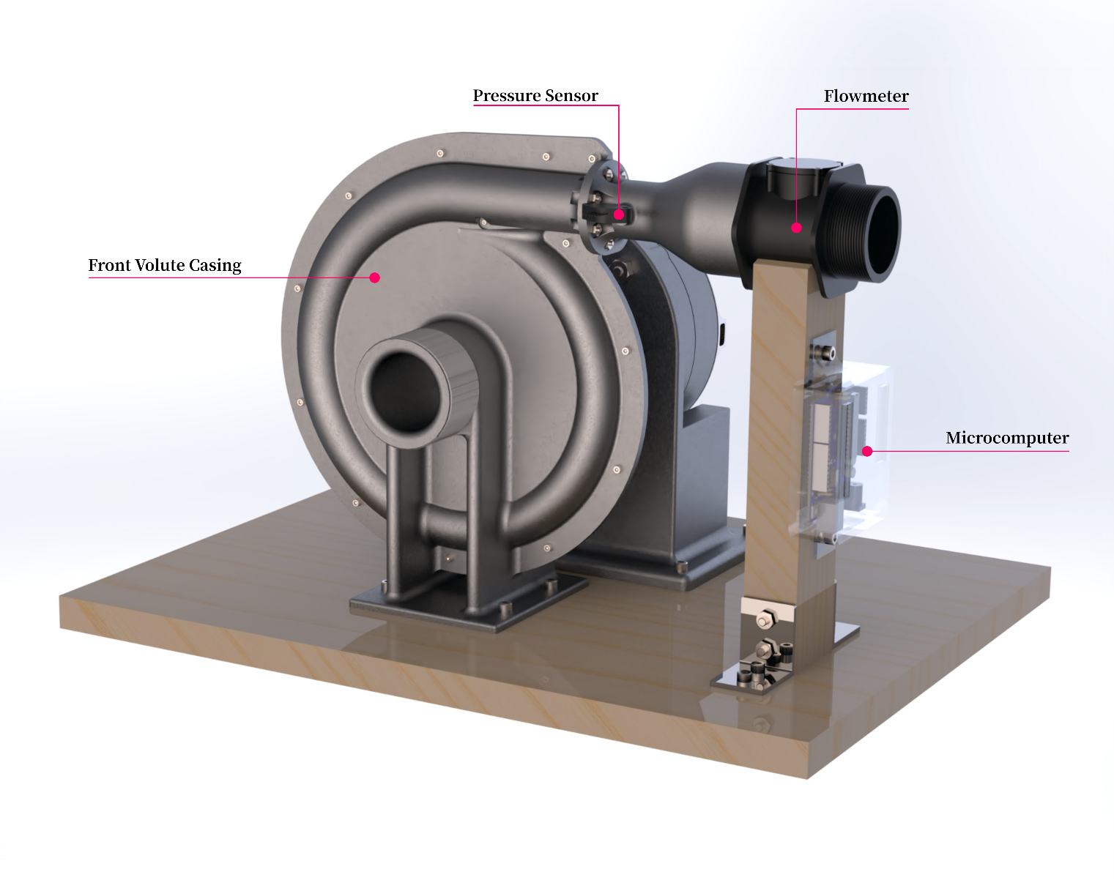

Tesla Turbine Design
FEEG6013 Group Design Project
Group 45 Year 2020/21
Group Members
Shawn Navarednam 29127076
Chow Kai Jie 29070651
Nicholas Khor Song En 29853818
Frederick Wong Kui Siung 29204461
Jerryl Ong Jun Wey 29859689
Supervisor: Dr Davide Lasagna
Co-Supervisor: Prof John Shrimpton
Notes:
Hello, my name is Jerryl and welcome to GDP 45’s presentation about the design of a Tesla Turbine. Let me start off by introducing our supervisor, Dr. Lasagna and co-supervisor, Professor Shrimpton, as well as the members of our group:
Shawn Navarednam
Chow Kai Jie
Nicholas Khor
Frederick Wong
And myself. Jerryl Ong

Slide 2
1. Introduction
Background
Literature Review
Organisation Chart
2. Design Brief
Aims and Objectives
Stakeholder Analysis
Design Specifications
3. Design Process
Design Process
Concept Designs
4. Analytical Model
Goals
Assumptions
Volute Casing Incorporation
Results
Design Variables Optimisation
5. CFD Model
Goals
Methodology
Results
6. Final Design Proposal
Component Selection
Proposed Manufacturing
Materials and Environmental Impact
7. Conclusion
Project Review
Future Work
Notes:
First of all, I will introduce the structure of our presentation shown on the left, which is loosely based off the flow of our project, shown on the right.
We start with the first section which introduces the project with a brief background into the problem that we’re trying to address, then a look at current Tesla Turbine works and finally, a statement of roles for each group member.
Then, we get into the design brief where the aims and objectives for the project are laid out, stakeholders and their needs identified, and this lets us specify parts of our design to address those needs.
With our specifications set, we delve into the design process which covers various aspects of design investigated: different geometries, features and their implications on turbine performance are briefly discussed. The fruition of which is to narrow down three main concept designs which we pick apart by addressing the different advantages and disadvantages that each one brings.
Our design is initialised using an analytical model which characterises the flow between discs in mathematical terms. The model allows us to define rotor parameters based on the design specifications and other external factors.
The calculations are backed up by the CFD simulations described in the next section which also evaluates the impact of our novel implementation of a volute casing into the Tesla Turbine.
All the work prior culminate to the finalised design specification as detailed in Section 6. In this section, we describe the choices and justifications made for each component.
Finally, we conclude our presentation with a review of the project outcomes and suggest possible future work to be done.
We start off with the introduction, where background is laid down and used to inform our next section, the design brief. The specifications laid out and adhered to throughout the design process, which involved the use of an analytical model and CFD simulations, covered in the next sections. With our findings we then propose our finalized design and a conclusion is laid out to summarise the project.

Slide 3
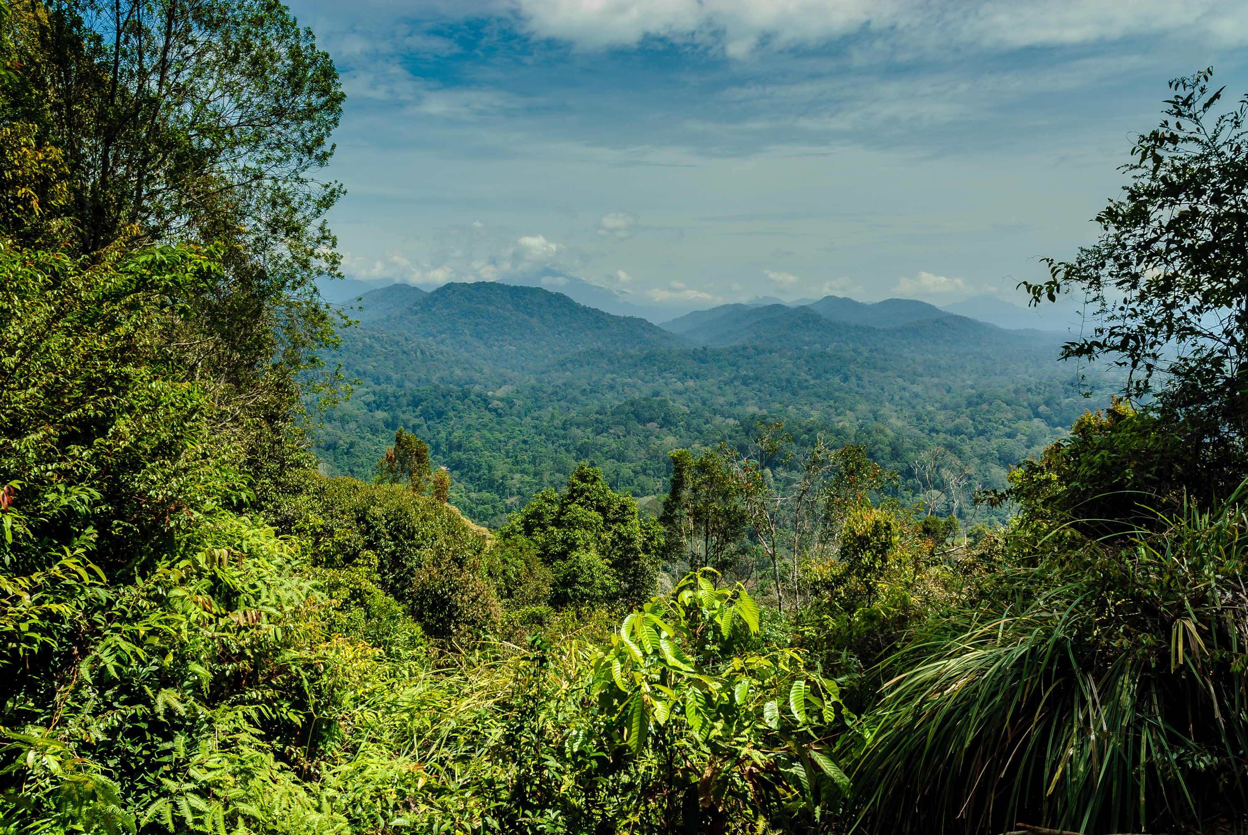
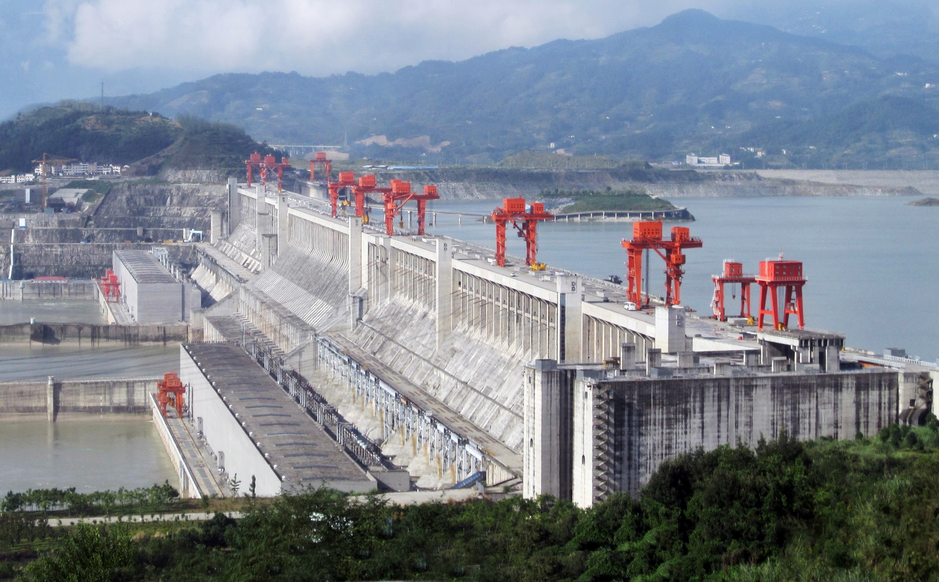
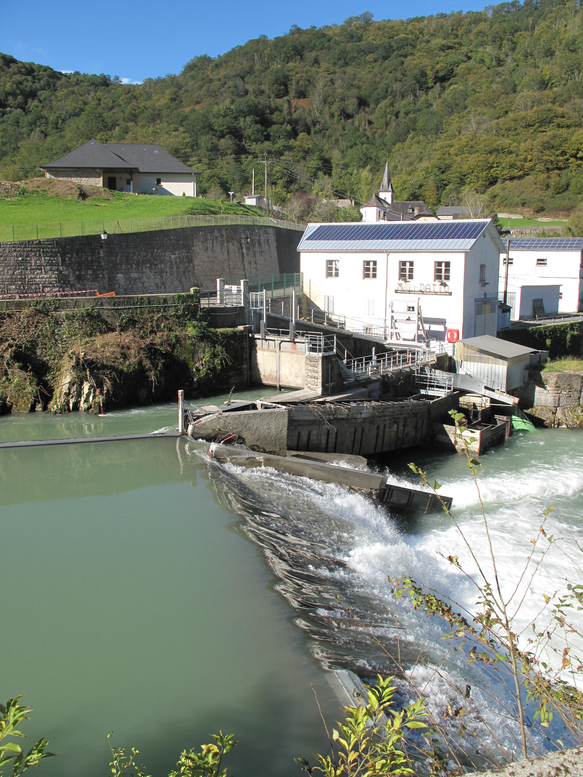
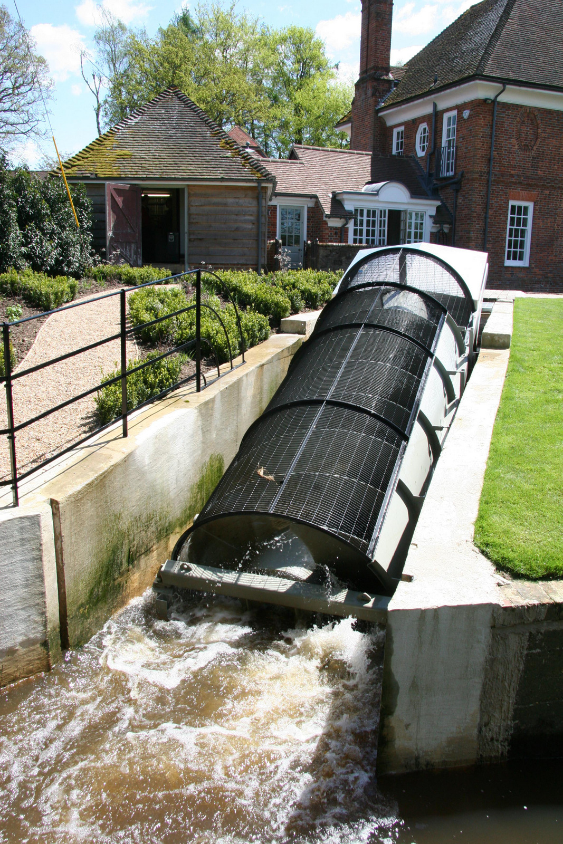
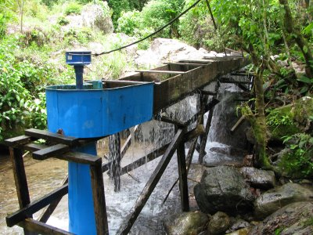
Hydropower Categories
Full-scale hydro
(> 10 MW)
Mini-hydro
(300 kW – 10 MW)
Micro-hydro
(5 kW – 300 kW)
Pico-hydro
(< 5 kW)
Rural Communities
Energy Decarbonisation
More than 80% of the Malaysian energy mix is derived from fossil fuels.
Rising productive population in rural communities, potential indicator for an increase in industry and need for energy
Working age (15 - 64) population percentage of rural communities in Malaysia.
Energy generation by source for Malaysia in 2018.
Notes:
We designed our Tesla Turbine to be used for pico-hydro applications where it would used to produce clean electricity reliably. Pico-hydro is a subcategory of hydropower used to describe hydroelectric devices generating less than 5 kW and it shows potential in addressing the challenge of rural electrification. Rural electrification is the act of providing communities living in rural regions access to electricity. In many cases, these rural communities do not have access to conventional grid facilities.
In Malaysia, almost a quarter of the country’s population are living in rural areas, representing a sizeable crowd of close to 8 million people. Although this population has been gradually decreasing over the years with urban migration, the proportion of working age people in rural communities is actually increasing, shown in this graph here, with more than 5 million people as of 2018.
Another point for the case of renewables in Malaysia is the need for energy decarbonisation. With more than 80% of the 2018 energy generation originating from fossil fuel sources, the Malaysian energy mix has significant potential for displacing the current fossil fuel dominance with low-carbon alternatives.

Slide 4
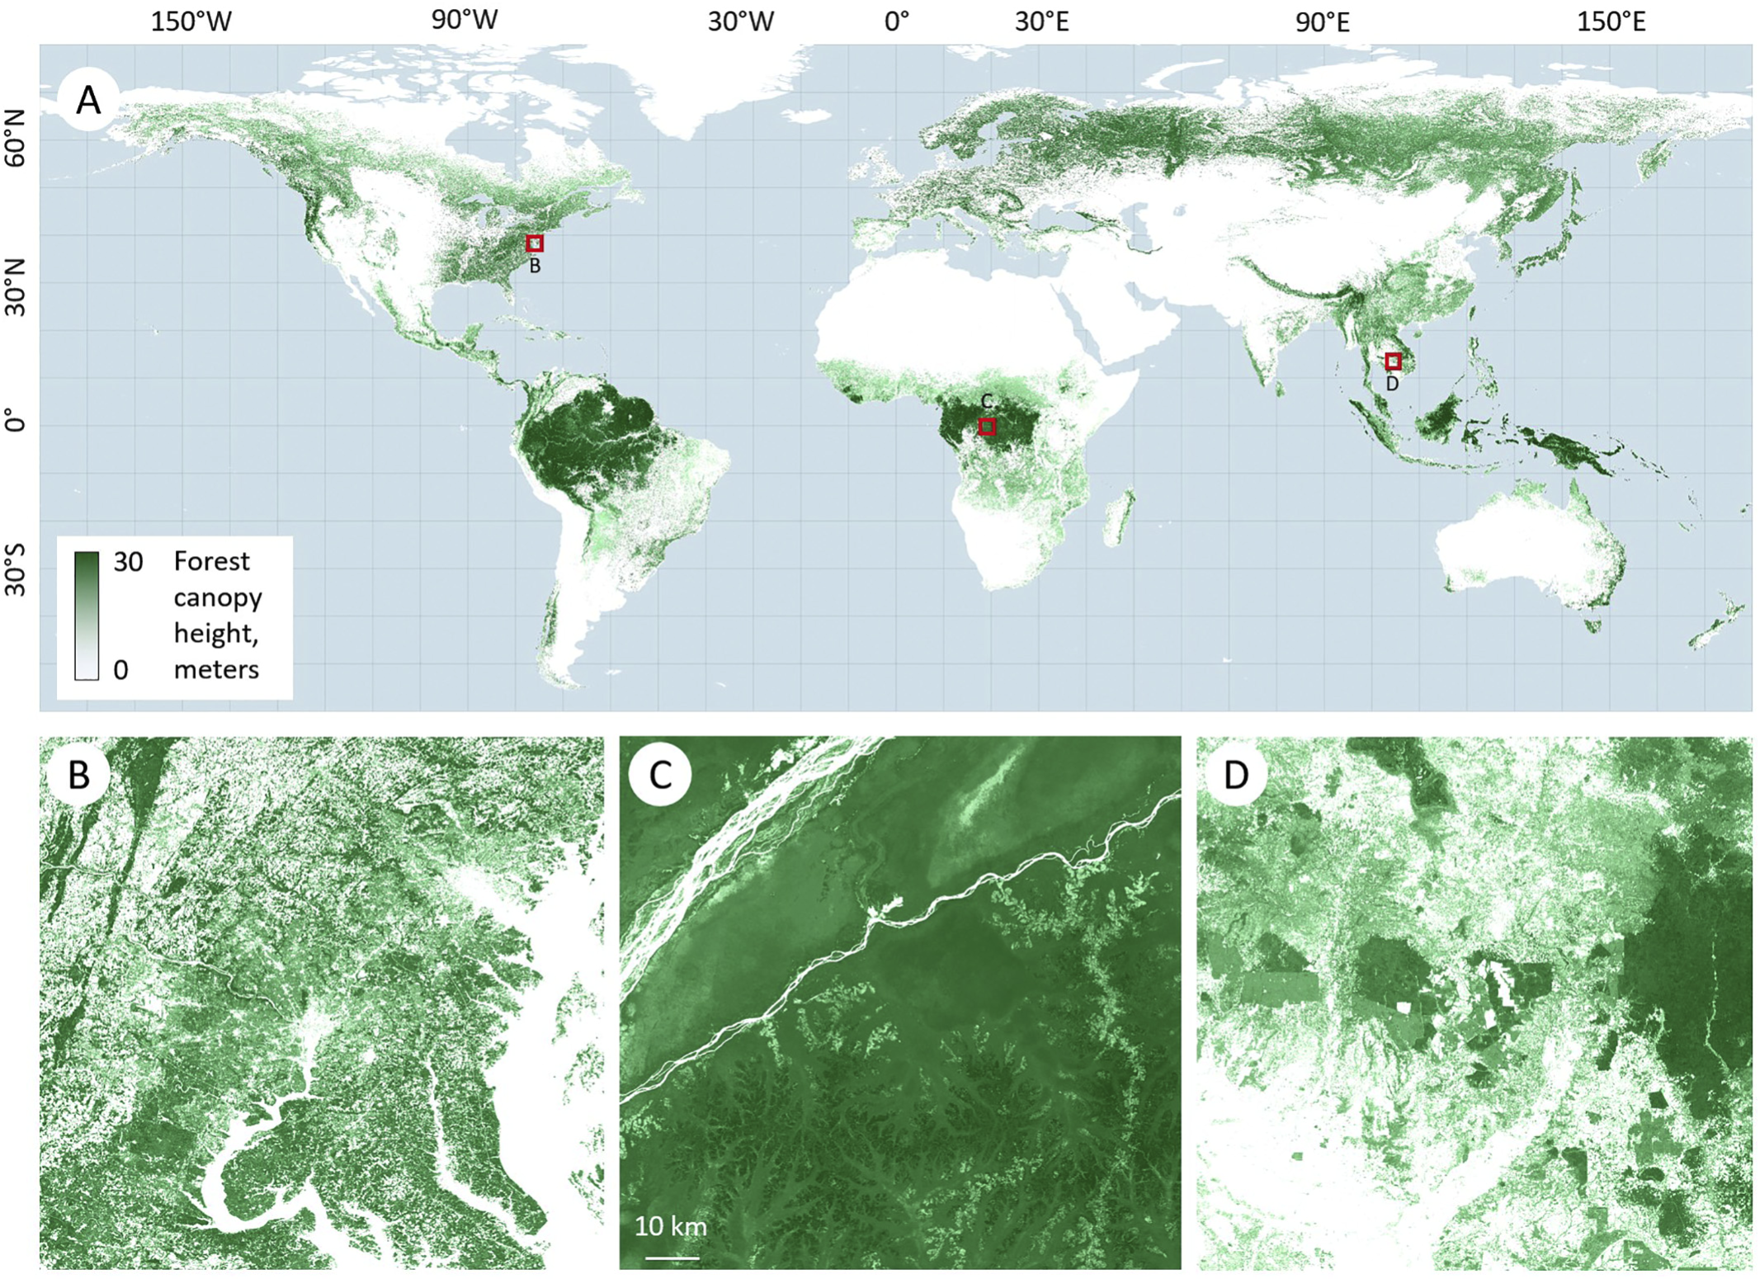




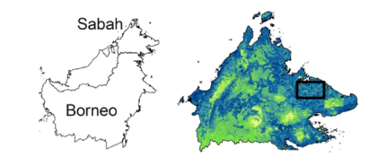

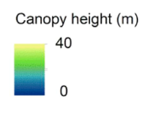
Tropical Jungle Canopy
Dense tropical rainforests consisting of tall trees, forming a high canopy.
Tree-cutting or tall infrastructure required for wind or solar installations.
$$$
>20 m
566 million cubic meters of annual surface runoff in Malaysia.
Emphasis on development of mini-hydro projects since the 4th Malaysian Plan.
Notes:
A majority of the rural areas in Malaysia are regions of dense tropical forest with high jungle canopies, making it more cost-intensive for solar as those trees are needed to be either overcome with tall infrastructure or cut down for a viable installation. The same issue is experienced by wind installations as tropical regions only experience significant average wind speed at high altitudes, much less so in the thick of the jungle.
Pico-hydro forgoes this limitation with its ability to take advantage of the height differences in local rivers or streams to generate electricity. In Malaysia, it is estimated that there is an annual surface run-off of 566 billion cubic meters of water, this combined with the country’s hilly areas gives it huge hydropower potential. This potential has not gone unnoticed with increasing emphasis place on the prospect of mini-hydro projects since the 4th Malaysian Plan in 1981

Slide 5
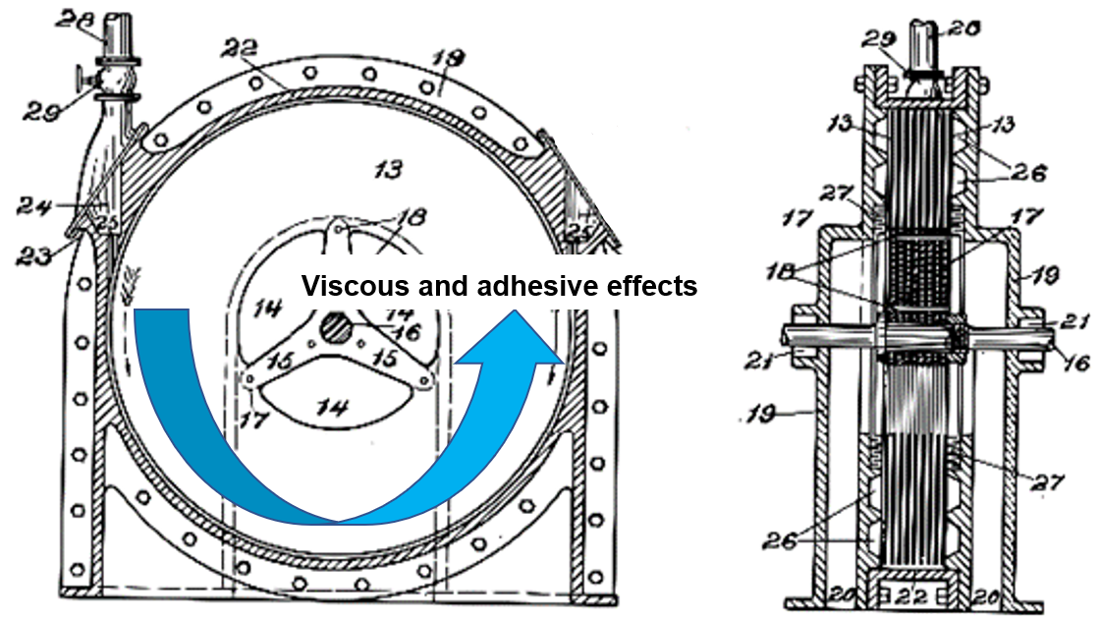
The Tesla Turbine
Inlet
Disc Stack
Key features
Energy extraction through the viscous and adhesive effects of a tangential jet of fluid acting on a series of parallel discs.
Less susceptible to damage and wear.
Easily manufacturable and replaceable parts.
Outlet
Sheet Metal
Easily manufacturable and replaced parts
Notes:
Our proposed device for pico-hydro is a Tesla Turbine, which sees water entering from the inlet as a tangential jet of fluid, the kinetic energy from the jet is transferred to a stack of parallel discs the action of viscous and adhesive effects. As the fluid loses energy, it spirals towards the centre of the disc and exits through the outlet. It differentiates itself from other turbines in that conventional water turbines such as Pelton wheels and Kaplan turbines typically rely on the impingement of water on a series of blades or buckets to generate torque. We believe that this lack of direct impingement in Tesla Turbines lets it be less susceptible to damage and wear.
This is coupled with the ease of maintenance whereby Tesla Turbine components are designed to be easily manufacturable using simple workshop equipment. We believe that these factors make it suited to deployment in rural communities as a source of cheap, reliable power.

Slide 6
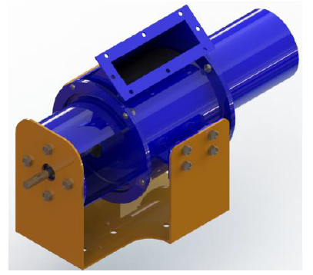
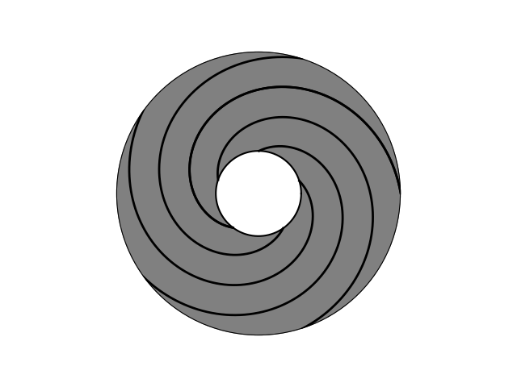
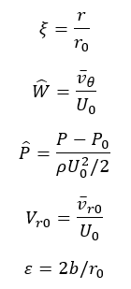
1.2 Literature Review
3 distinct fields of literature investigated
1. Past works into the application of turbines including Tesla Turbines in pico hydro settings.
2. Methodologies for characterising Tesla Turbine flow:
Analytical Models Computational Fluid Dynamics
3. Geometrical parameters which most influence the Tesla Turbine performance:
Nozzle geometry
Disc outer spacing
Disc outer diameter
Disc spacing distance
Disc thickness
Notes:
Before embarking on our own design, we investigated a wide array of literature surrounding Tesla Turbines to ensure a solid foundation behind our design choices. The scope of works that we reviewed can be classified into three distinct categories surrounding different aspects of the Tesla Turbine.
The first of which being application of turbines including Tesla Turbines in hydropower settings, which served to give us some indication of the challenges involved specifically with hydroelectricity and using water as a medium.
The second category encompasses the various methodologies used to characterise the flow in the Tesla Turbine. These gave us a way to model and simulate our Tesla Turbine design and evaluate its performance.
The final group being specific geometrical parameters in places such as the nozzle, volute tongue, and discs. We noticed that there was a lack of designs incorporating the use of volute casings in a water medium despite intensive research into open flow applications. Hence, we looked into utilising a volute casing to channel flow into the interdisc space, preventing sudden pressure drops and maintaining a uniform angle of attack.

Slide 7
1.3 Organisation Chart
Supervisor
Davide Lasagna
CFD Lead
Shawn Navarednam
Numerical Analysis Lead
Chow Kai Jie
Logistics Lead
Nicholas Khor Song En
Material Selection Lead
Jerryl Ong Jun Wey
Design Lead
Frederick Wong Kui Siung
Notes:
With the scope of work defined, each member of our group took on a different aspect of our project.
Shawn Navarednam as the CFD Lead
Nicholas Khor as the Logistics Lead
Frederick Wong as the Design Lead
Jerryl Ong as the Material Selection Lead
Kai Jie as the Numerical Analysis Lead

Slide 8
1. Introduction
Background
Literature Review
Organisation Chart
2. Design Brief
Aims and Objectives
Stakeholder Analysis
Design Specifications
3. Design Process
Design Process
Concept Designs
4. Analytical Model
Goals
Assumptions
Volute Casing Incorporation
Results
Design Variables Optimisation
5. CFD Model
Goals
Methodology
Results
6. Final Design Proposal
Component Selection
Proposed Manufacturing
Materials and Environmental Impact
7. Conclusion
Project Review
Future Work

Slide 9
2.1 Aims and Objectives
Goal: Design and optimise a Tesla Turbine for pico hydro applications capable of providing a useful and reliable source of power at an affordable price.
Objectives:
Identifying with justification a target region for pico hydro implementation.
Reviewing the current state of hydro and smaller scale hydro in the aforementioned region.
Sizing the Tesla Turbine based on target power output and ideal use cases.
Design the entire Tesla Turbine assembly and its supporting components.
Validate and further optimise the design via analytical solutions.
Notes:
Goal: Design and optimise a Tesla Turbine for pico hydro applications capable of providing a useful and reliable source of power at an affordable price.
In order to achieve our goal, the following objectives were set:
Identifying with justification the niche for pico-hydro Tesla Turbine implementation
Reviewing the current state of hydro and smaller scale hydro in the aforementioned region.
Design the entire Tesla Turbine assembly and its supporting components.
Sizing optimisation of the turbine design based on target power output via analytical solutions.
Validate analytical results with that from CFD simulations.

Slide 10
2.2 Stakeholder Analysis
Stakeholder | Needs and Interests | Actions Taken
Supervisors | Original idea for the Tesla Turbine in a hydropower setting from Dr. Lasagna. Alongside with the technical advisory provided by Professor Shrimpton, both parties are invested in the development and outcomes of the present work. | Weekly meetings for general progress and queries. Open channel of communication via Microsoft Team and/or email to address specific queries.
Team Members | Communication between members in lieu of the collaborative effort required to complete this work. Cooperation between members in contributing and improving the present work | Regular meetings. Open channel of communication via Microsoft Team and/or WhatsApp group chat.
Rural communities | Preservation of local environment and ecosystems. Cost-effective solution. | Product footprint as key factor in design process. Product cost as key factor in design process.
Notes:
We identified several direct and indirect stakeholders of our project, in this presentation, I will talk through three of the main parties concerned.
The first two being the project supervisors and team members.
With the concept of the Tesla Turbine coming from Dr. Lasagna, and the contributions in technical advisory by both supervisors make them invested in the development and outcomes of the project. We addressed their needs as well as that of the team members by having regular meetings and an open channel of communication should comments or critiques come through.
The third main stakeholder is that of the target rural communities. We understand their needs for the preservation of the local environment and low-cost solutions, hence the specifications of cost and size limits in the design.

Slide 11
2.3 Design Specifications
Feature | Target
Power Output | 100 W
Physical footprint | < 30 × 30 × 30 cm³
Weight | < 30 kg
Purchase Cost | Less than £200 (commercial manufacturing)
Notes:
We decided on a rated power specification of 100 W as a compromise between usability and portability. Higher ratings would demand more scale and materials whilst too low of a would limit use cases to low-power situations.
In terms of scale, we set 30 centimeters in each dimension as the limit to enable deployment in smaller streams, and 30 kg as to be manageable by two adults. Finally, we set a cost limit of 200 pounds as to make it affordable.

Slide 12
1. Introduction
Background
Literature Review
Organisation Chart
2. Design Brief
Aims and Objectives
Stakeholder Analysis
Design Specifications
3. Design Process
Design Process
Concept Designs
4. Analytical Model
Goals
Assumptions
Volute Casing Incorporation
Results
Design Variables Optimisation
5. CFD Model
Goals
Methodology
Results
6. Final Design Proposal
Component Selection
Proposed Manufacturing
Materials and Environmental Impact
7. Conclusion
Project Review
Future Work

Slide 13
3.1 Design Process
Quantifying external parameters and performance targets.
Initialise rotor parameters using analytical solutions.
Forming the preliminary design of the turbine exterior and supporting components based on rotor.
Cross-validation of analytical solutions and CFD results.
Further component design optimisation using CFD.
Notes:
During the design stage, we first quantified the external parameters and established the performance targets. Analytical model is then developed to initialise the rotor parameters to form a preliminary design of the turbine exterior and to support the components based on the rotor. CFD results are cross validated with the developed analytical solutions before further optimising the component in CFD

Slide 14
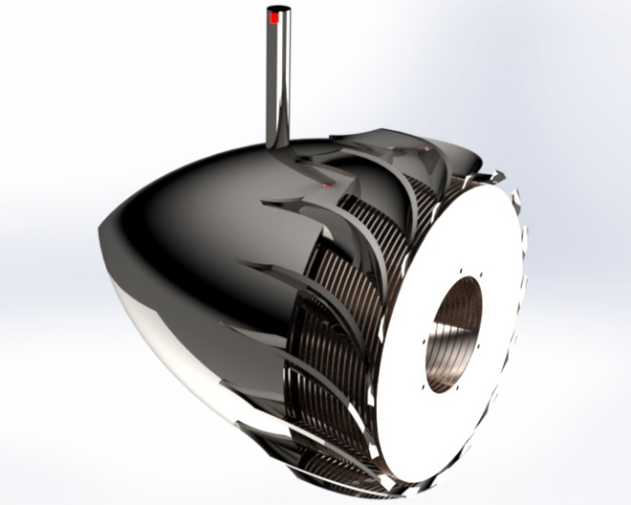
3.2 Concept Designs
Radial turbine inspired
Advantages
Least dependent on water source angle of attack.
Able to handle large mass flow rates. Easy to implement in open water sources.
Flow outlet would be oriented downstream of the flow, the probability of backflow is lower.
Disadvantages
Challenging to manufacture. It is expected that the lead time required would be too long and manufacturing costs will be high.
Requires gears to link the tesla turbine discs with the alternator shaft. Durability issues.
Requires waterproofing of gears with a labyrinth seal to ensure durability.
Flow angle is changed abruptly, resulting in losses.
Using CFD, pressure losses were prominent within the case, especially nearing the vane region.
Notes:
Refer to lite when explaining

Slide 15
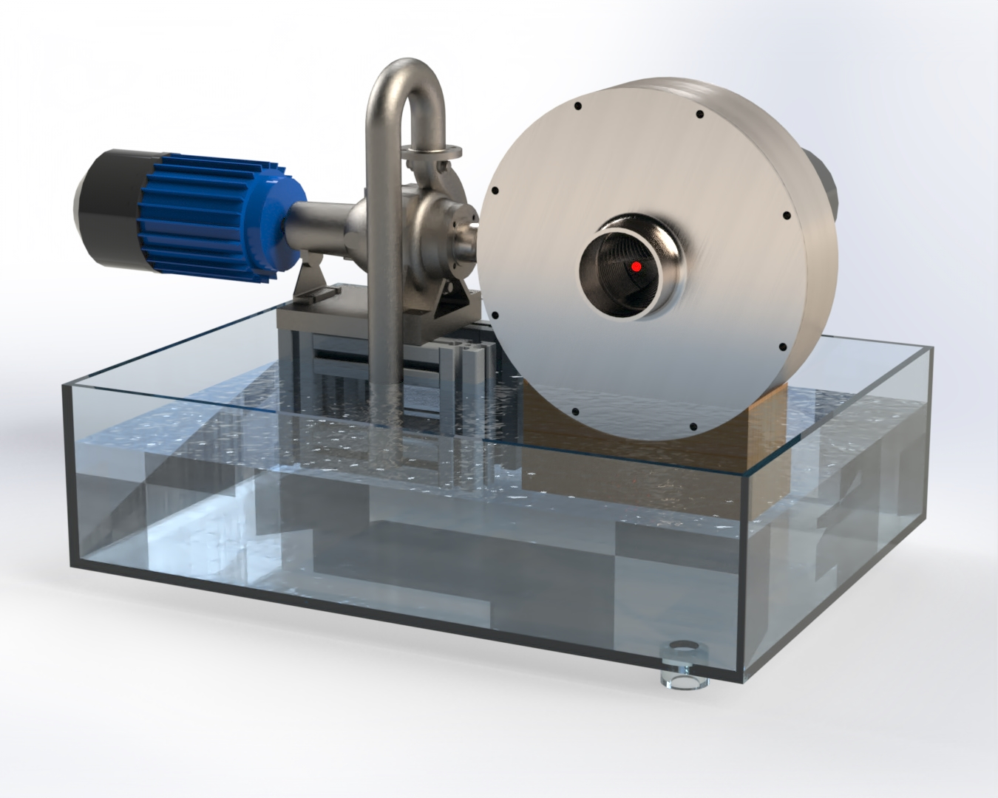
3.2 Concept Designs
Plenum Chamber
Advantages
Multiple inlets.
Angle of attack can be easily varied using 3D printing
Thickness and material of outer casing.
Less sensitive to pulsating flows
Lower pressure losses (CFD validated)
Disadvantages
Long lead time and have high costs for outer plenum chamber manufacture
Challenging to 3D-print stator nozzle with sufficient precision given the facilities. Nozzle exit point must have a ultra-small area for significant flow acceleration.
Triple spiral patterns proved to be too difficult to manufacture, mainly due to being too thin.

Slide 16
1. Introduction
Background
Literature Review
Organisation Chart
2. Design Brief
Aims and Objectives
Stakeholder Analysis
Design Specifications
3. Design Process
Design Process
Concept Designs
4. Analytical Model
Goals
Assumptions
Volute Casing Incorporation
Results
Design Variables Optimisation
5. CFD Model
Goals
Methodology
Results
6. Final Design Proposal
Component Selection
Proposed Manufacturing
Materials and Environmental Impact
7. Conclusion
Project Review
Future Work

Slide 17
4.0 Goals of Analytical Modelling of Tesla Turbine Performance
Optimising Tesla Turbine’s design via simple analytical numerical schemes.
Characterising flow behaviour between two rotating discs and its impacts on power generation.
Determining the impacts of design scaling on the overall turbine performance.
Analytical validation of flow assumptions with that obtained from CFD and past work

Slide 18
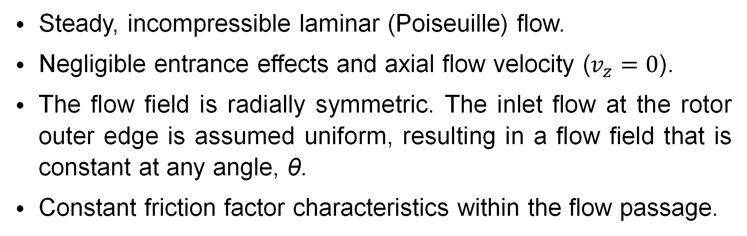
4.1 Assumptions
Steady, incompressible laminar (Poiseuille) flow.
Negligible entrance effects and axial flow velocity ($v_{z}=0$).
The flow field is radially symmetric. The inlet flow at the rotor outer edge is assumed uniform, resulting in a flow field that is constant at any angle, θ.
Constant friction factor characteristics within the flow passage.

Slide 19
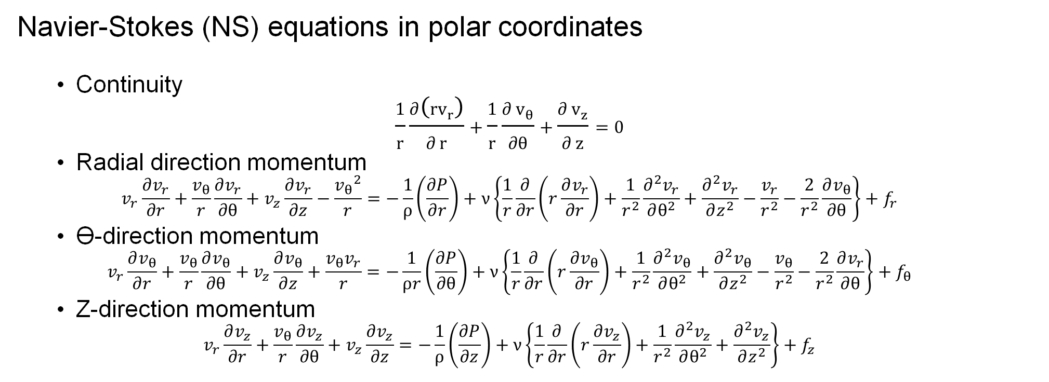
4.2 Equations
Navier-Stokes (NS) equations in polar coordinates
Continuity
$$\frac{1}{r}\frac{∂\left(rv_{r}\right)}{∂ r}+\frac{1}{r}\frac{∂ v_{θ}}{∂θ}+\frac{∂ v_{z}}{∂ z}=0$$
Radial direction momentum
$$v_{r}\frac{∂v_{r}}{∂r}+\frac{v_{θ}}{r}\frac{∂v_{r}}{∂θ}+v_{z}\frac{∂v_{r}}{∂z}−\frac{{v_{θ}}^{2}}{r}=−\frac{1}{ρ}\left(\frac{∂P}{∂r}\right)+ν\left\{\frac{1}{r}\frac{∂}{∂r}\left(r\frac{∂v_{r}}{∂r}\right)+\frac{1}{r^{2}}\frac{∂^{2}v_{r}}{∂θ^{2}}+\frac{∂^{2}v_{r}}{∂z^{2}}−\frac{v_{r}}{r^{2}}−\frac{2}{r^{2}}\frac{∂v_{θ}}{∂θ}\right\}+f_{r}$$
ϴ-direction momentum
$$v_{r}\frac{∂v_{θ}}{∂r}+\frac{v_{θ}}{r}\frac{∂v_{θ}}{∂θ}+v_{z}\frac{∂v_{θ}}{∂z}+\frac{v_{θ}v_{r}}{r}=−\frac{1}{ρr}\left(\frac{∂P}{∂θ}\right)+ν\left\{\frac{1}{r}\frac{∂}{∂r}\left(r\frac{∂v_{θ}}{∂r}\right)+\frac{1}{r^{2}}\frac{∂^{2}v_{θ}}{∂θ^{2}}+\frac{∂^{2}v_{θ}}{∂z^{2}}−\frac{v_{θ}}{r^{2}}−\frac{2}{r^{2}}\frac{∂v_{r}}{∂θ}\right\}+f_{θ}$$
Z-direction momentum
$$v_{r}\frac{∂v_{z}}{∂r}+\frac{v_{θ}}{r}\frac{∂v_{z}}{∂θ}+v_{z}\frac{∂v_{z}}{∂z}=−\frac{1}{ρ}\left(\frac{∂P}{∂z}\right)+ν\left\{\frac{1}{r}\frac{∂}{∂r}\left(r\frac{∂v_{z}}{∂r}\right)+\frac{1}{r^{2}}\frac{∂^{2}v_{z}}{∂θ^{2}}+\frac{∂^{2}v_{z}}{∂z^{2}}\right\}+f_{z}$$

Slide 20
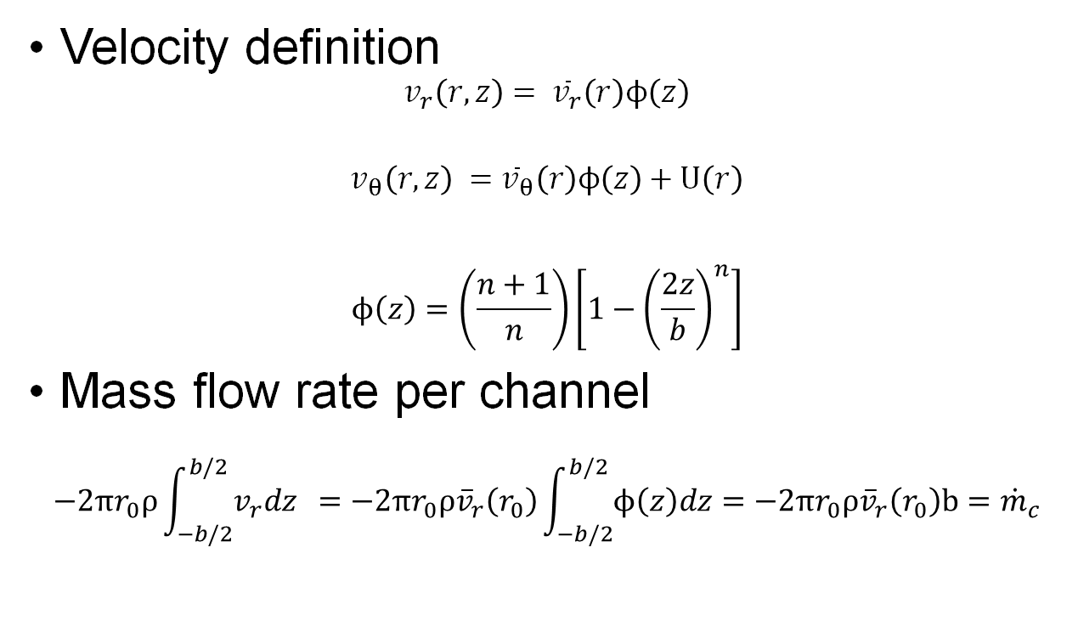
4.2 Equations
Velocity definition
$$v_{r}\left(r,z\right)= {\overline{v}}_{r}\left(r\right)ϕ\left(z\right)$$
$$v_{θ}\left(r,z\right) ={\overline{v}}_{θ}\left(r\right)ϕ\left(z\right)+U\left(r\right)$$
$$ϕ\left(z\right)=\left(\frac{n+1}{n}\right)\left[1−{\left(\frac{2z}{b}\right)}^{n}\right]$$
Mass flow rate per channel
$$−2πr_{0}ρ\int_{−b/2}^{b/2}{v_{r}dz} =−2πr_{0}ρ{\overline{v}}_{r}\left(r_{0}\right)\int_{−b/2}^{b/2}{ϕ\left(z\right)dz}=−2πr_{0}ρ{\overline{v}}_{r}\left(r_{0}\right)b={\dot{m}}_{c}$$

Slide 21
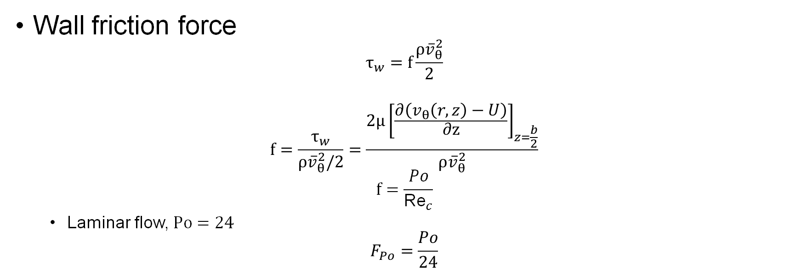
4.2 Equations
Wall friction force
$$τ_{w}=f\frac{ρ{\overline{v}}_{θ}^{2}}{2}$$
$$f=\frac{τ_{w}}{ρ{\overline{v}}_{θ}^{2}/2}=\frac{2μ{\left[\frac{∂\left(v_{θ}\left(r,z\right)−U\right)}{∂z}\right]}_{z=\frac{b}{2}}}{ρ{\overline{v}}_{θ}^{2}}$$
$$f=\frac{Po}{{\text{Re}}_{c}}$$
Laminar flow, $Po=24$
$$F_{Po}=\frac{Po}{24}$$

Slide 22
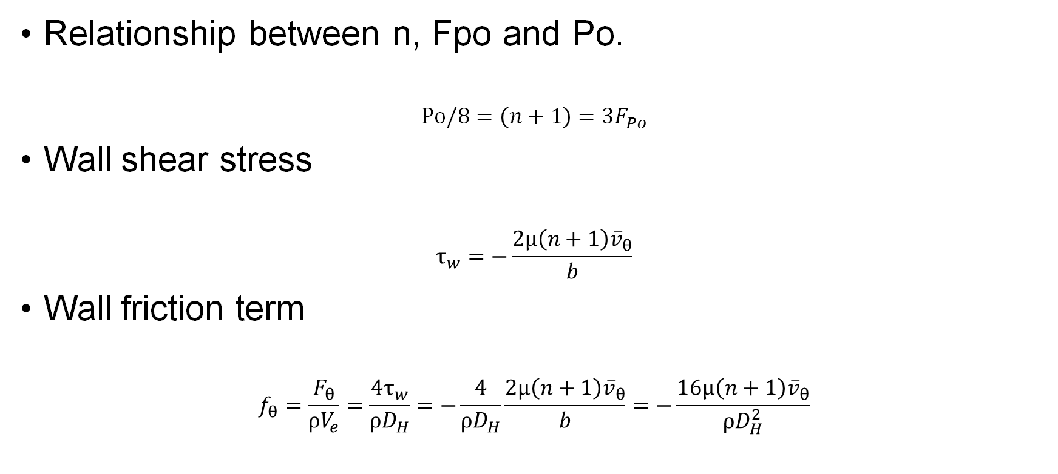
4.2 Equations
Relationship between n, Fpo and Po.
$$Po/8=\left(n+1\right)=3F_{Po}$$
Wall shear stress
$$τ_{w}=−\frac{2μ\left(n+1\right){\overline{v}}_{θ}}{b}$$
Wall friction term
$$f_{θ}=\frac{F_{θ}}{ρV_{e}}=\frac{4τ_{w}}{ρD_{H}}=−\frac{4}{ρD_{H}}\frac{2μ\left(n+1\right){\overline{v}}_{θ}}{b}=−\frac{16μ\left(n+1\right){\overline{v}}_{θ}}{ρD_{H}^{2}}$$

Slide 23
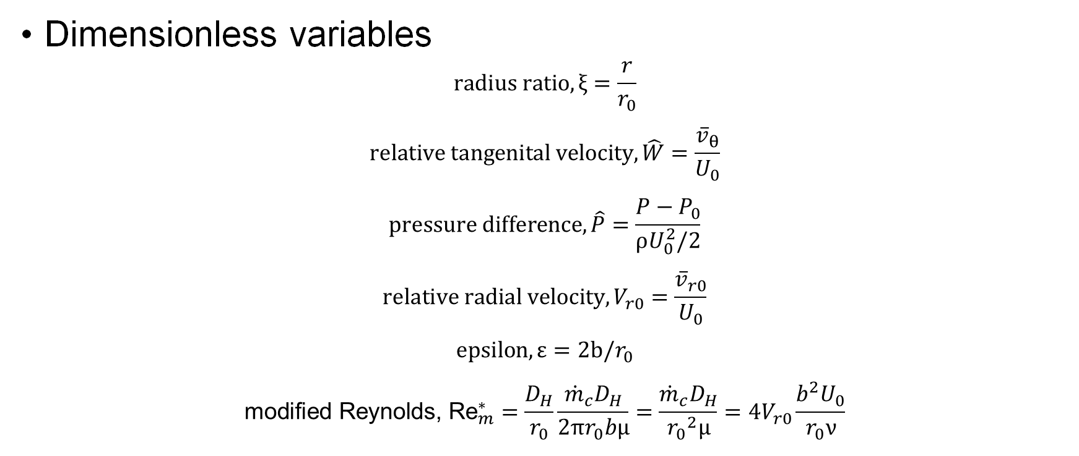
4.2 Equations
Dimensionless variables
$$radius ratio, ξ=\frac{r}{r_{0}}$$
$$relative tangenital velocity, \hat{W}=\frac{{\overline{v}}_{θ}}{U_{0}}$$
$$pressure difference, \hat{P}=\frac{P−P_{0}}{ρU_{0}^{2}/2}$$
$$relative radial velocity, V_{r0}=\frac{{\overline{v}}_{r0}}{U_{0}}$$
$$epsilon, ε=2b/r_{0}$$
$${\text{modified} \text{Reynolds}\text{, }\text{Re}}_{m}^{∗}=\frac{D_{H}}{r_{0}}\frac{{\dot{m}}_{c}D_{H}}{2πr_{0}bμ}=\frac{{\dot{m}}_{c}D_{H}}{{r_{0}}^{2}μ}=4V_{r0}\frac{b^{2}U_{0}}{r_{0}ν}$$

Slide 24
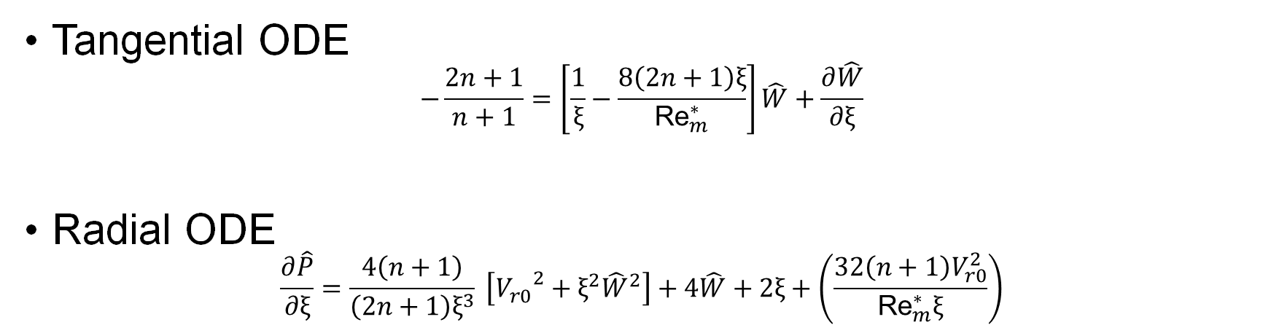
4.2 Equations
Tangential ODE
$$−\frac{2n+1}{n+1}=\left[\frac{1}{ξ}−\frac{8\left(2n+1\right)ξ}{{\text{Re}}_{m}^{∗}}\right]\hat{W}+\frac{∂\hat{W}}{∂ξ}$$
Radial ODE
$$\frac{∂\hat{P}}{∂ξ}=\frac{4\left(n+1\right)}{\left(2n+1\right)ξ^{3}} \left[{V_{r0}}^{2}+ξ^{2}{\hat{W}}^{2}\right]+4\hat{W}+2ξ+\left(\frac{32\left(n+1\right)V_{r0}^{2}}{{\text{Re}}_{m}^{∗}ξ}\right)$$

Slide 25
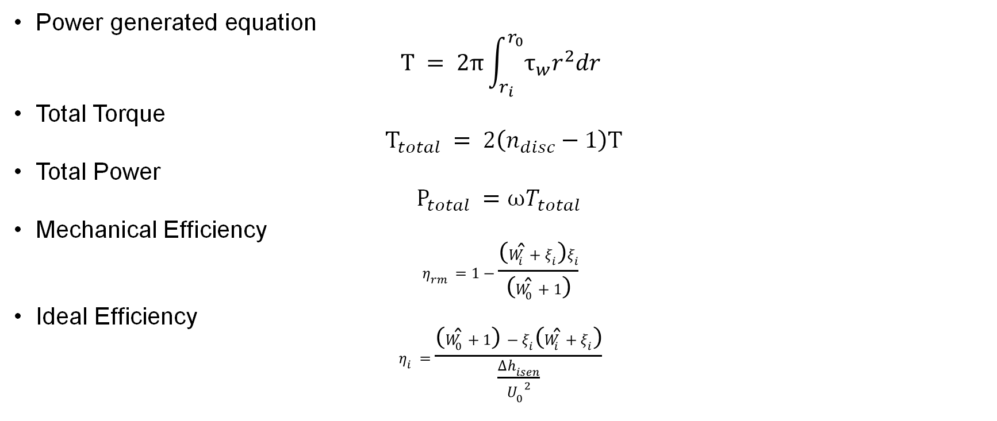
4.2 Equations
Power generated equation
$$T = 2π\int_{r_{i}}^{r_{0}}{τ_{w}r^{2}dr}$$
Total Torque
$${ T}_{total} = 2\left(n_{disc}−1\right)T$$
Total Power
$$P_{total} =ωT_{total}$$
Mechanical Efficiency
$$η_{rm}=1−\frac{\left({\hat{W}}_{i}+ξ_{i}\right)ξ_{i}}{\left({\hat{W}}_{0}+1\right)}$$
Ideal Efficiency
$$η_{i}=\frac{\left({\hat{W}}_{0}+1\right)−ξ_{i}\left({\hat{W}}_{i}+ξ_{i}\right)}{\frac{∆h_{isen}}{{U_{0}}^{2}}}$$

Slide 26
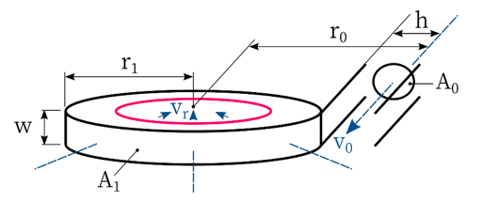
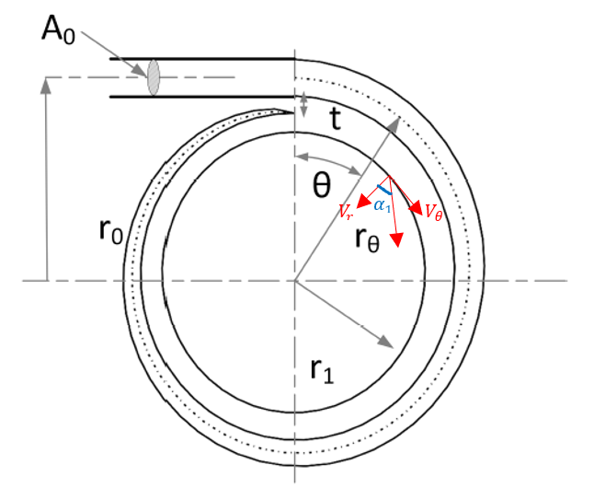
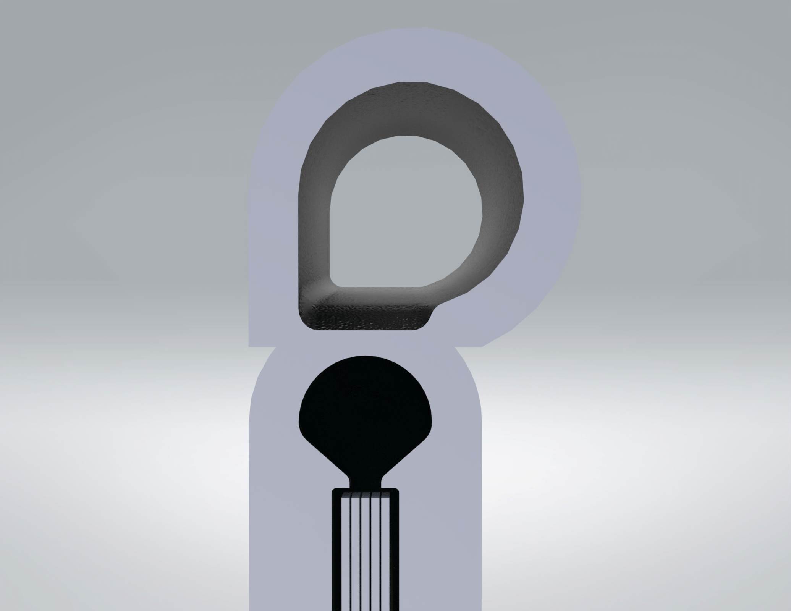
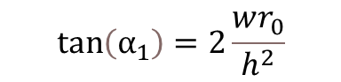
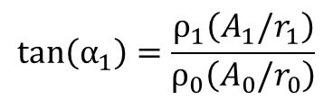
4.3 Volute Casing Incorporation
Taper
Exit flow angle
$$tan\left(α_{1}\right)=\frac{ρ_{1}\left(A_{1}/r_{1}\right)}{ρ_{0}\left(A_{0}/r_{0}\right)}$$
$$tan\left(α_{1}\right)=2\frac{wr_{0}}{h^{2}}$$
Notes:
Which equation do u want?

Slide 27
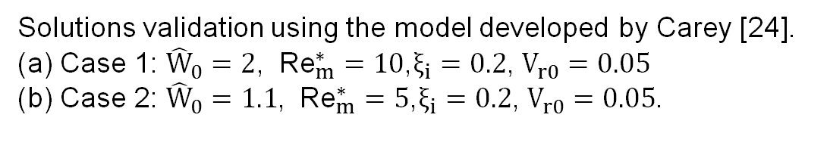
4.4 Results
Flow solutions corresponding to the varying cases and initial conditions
Solutions validation using the model developed by Carey [24].
(a) Case 1: ${\hat{W}}_{0}=2$, ${\text{Re}}_{m}^{∗}=10$,$ξ_{i}=0.2$, $V_{r0}=0.05$ (b) Case 2: ${\hat{W}}_{0}=1.1$, ${\text{Re}}_{m}^{∗}=5$,$ξ_{i}=0.2$, $V_{r0}=0.05$.

Slide 28
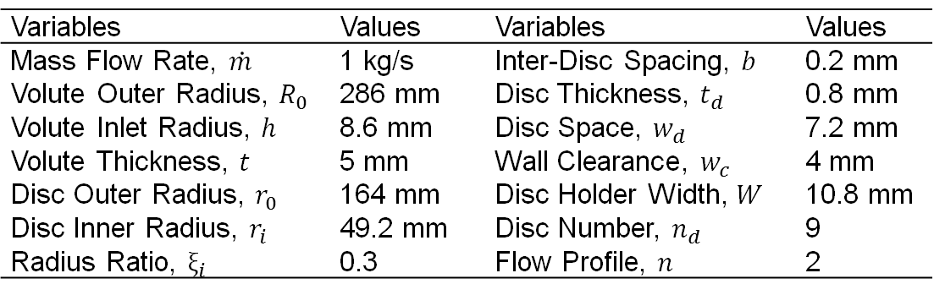
4.5 Design Variables Optimisation
Underline core design parameters for optimisation purposes
Table of variables and corresponding values
Variables | Values | Variables | Values
Mass Flow Rate, $\dot{m}$ | 1 kg/s | Inter-Disc Spacing, $b$ | 0.2 mm
Volute Outer Radius, $R_{0}$ | 286 mm | Disc Thickness, $t_{d}$ | 0.8 mm
Volute Inlet Radius, $h$ | 8.6 mm | Disc Space, $w_{d}$ | 7.2 mm
Volute Thickness, $t$ | 5 mm | Wall Clearance, $w_{c}$ | 4 mm
Disc Outer Radius, $r_{0}$ | 164 mm | Disc Holder Width, $W$ | 10.8 mm
Disc Inner Radius, $r_{i}$ | 49.2 mm | Disc Number, $n_{d}$ | 9
Radius Ratio, $ξ_{i}$ | 0.3 | Flow Profile, $n$ | 2

Slide 29
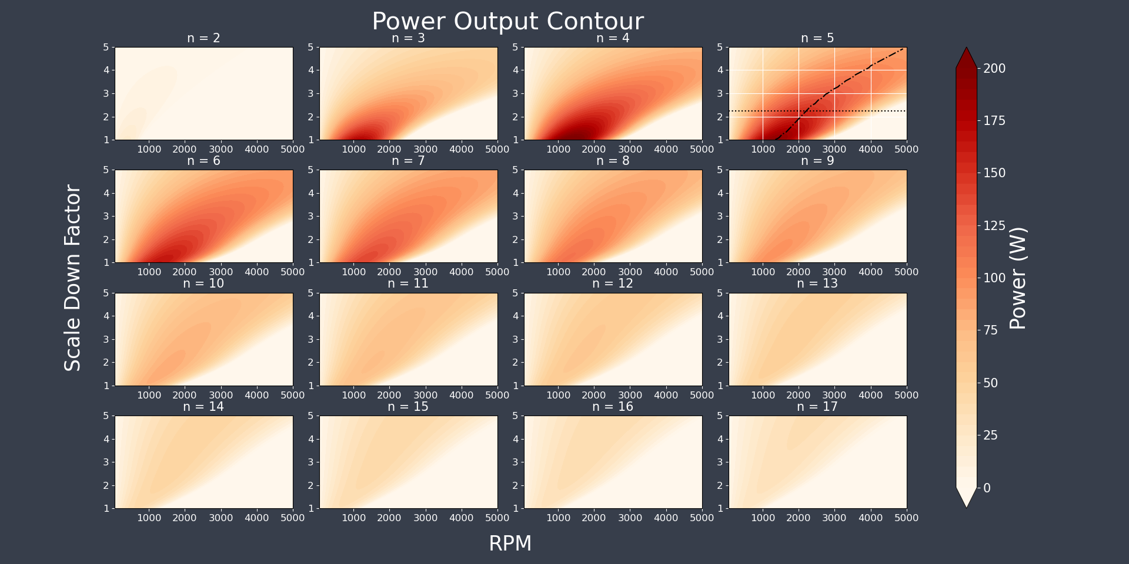
4.5 Design Variables Optimisation
Power Output Contour at varying disc numbers, RPM and scaling down factor, k.
Notes:
Maybe a zoom-in on the n = 5 plot?

Slide 30
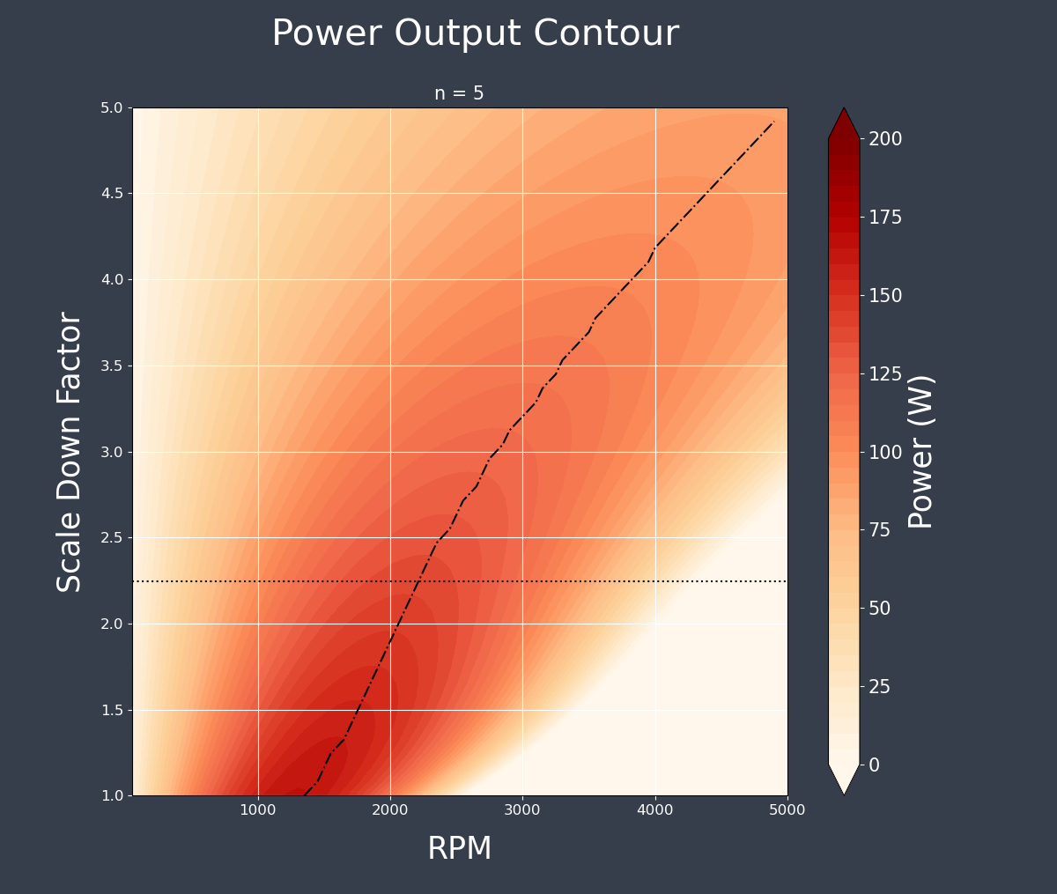
4.5 Design Variables Optimisation
Power Output Contour at n=5
Notes:
Maybe a zoom-in on the n = 5 plot?

Slide 31
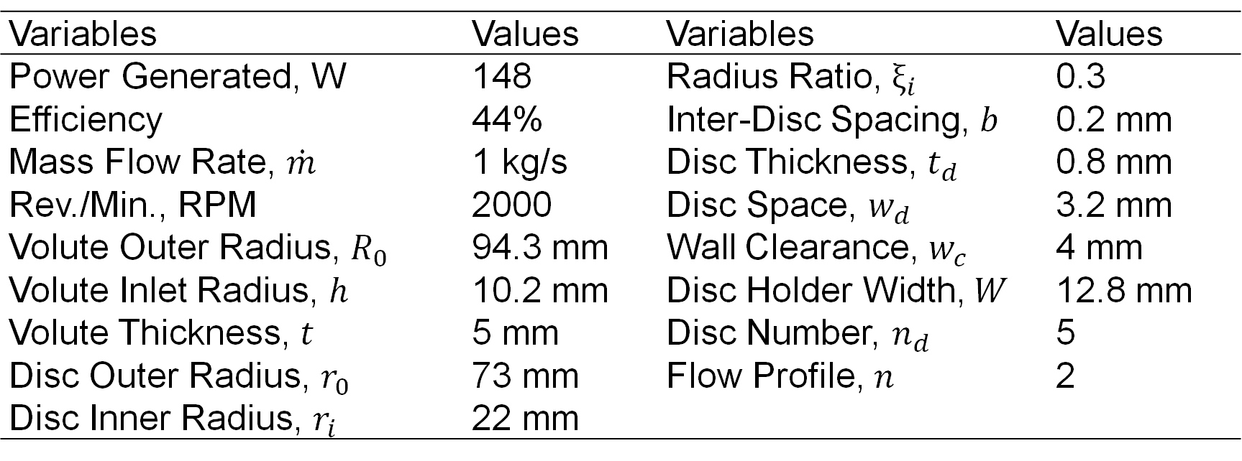
4.5 Design Variables Optimisation
Base Turbine Design Parameters
Variables | Values | Variables | Values
Power Generated, W | 148 | Radius Ratio, $ξ_{i}$ | 0.3
Efficiency | 44% | Inter-Disc Spacing, $b$ | 0.2 mm
Mass Flow Rate, $\dot{m}$ | 1 kg/s | Disc Thickness, $t_{d}$ | 0.8 mm
Rev./Min., RPM | 2000 | Disc Space, $w_{d}$ | 3.2 mm
Volute Outer Radius, $R_{0}$ | 94.3 mm | Wall Clearance, $w_{c}$ | 4 mm
Volute Inlet Radius, $h$ | 10.2 mm | Disc Holder Width, $W$ | 12.8 mm
Volute Thickness, $t$ | 5 mm | Disc Number, $n_{d}$ | 5
Disc Outer Radius, $r_{0}$ | 73 mm | Flow Profile, $n$ | 2
Disc Inner Radius, $r_{i}$ | 22 mm

Slide 32
1. Introduction
Background
Literature Review
Organisation Chart
2. Design Brief
Aims and Objectives
Stakeholder Analysis
Design Specifications
3. Design Process
Design Process
Concept Designs
4. Analytical Model
Goals
Assumptions
Volute Casing Incorporation
Results
Design Variables Optimisation
5. CFD Model
Goals
Methodology
Results
6. Final Design Proposal
Component Selection
Proposed Manufacturing
Materials and Environmental Impact
7. Conclusion
Project Review
Future Work

Slide 33
5.0 Goals of CFD
Check for the flow field performance within the turbine test models.
This would include recirculation regions and pressure drop investigation across both the turbine and disc regions.
Refine the volute casing geometry, preventing sudden drops in pressure and recirculation regions.
Flow variables were compared to that of the analytical model for validation.
Notes:
For all models, CFD simulation was carried out to check for the flow field performance within the casing and between the discs. We look out for recirculation and drastic pressure drop regions across both the turbine and disc. For every design iteration and concept, CFD was used to consult on design changes to be implemented. In the final design, CFD was employed to refine the volute casing geometry on top of ensuring sufficient mesh resolution in capturing the flow profile evolution in between the discs. More importantly, the flow variables were compared to that of the analytical model for validation

Slide 34
5.1 Methodology – Pre-processing
Designed base models in SolidWorks and exported as STEP files.
Volume extract function in Design Modeler to model inner flow domain of both the volute casing and disc.
Realigned the domain to the origin for easier extraction of flow variables
Notes:
Models were pre-processed using Solidworks and exported as STEP files into DesignModeler, where the domain was extracted for both the volute casing and discs. The simulation domain was then realigned to the origin to ease post-processing later on.

Slide 35
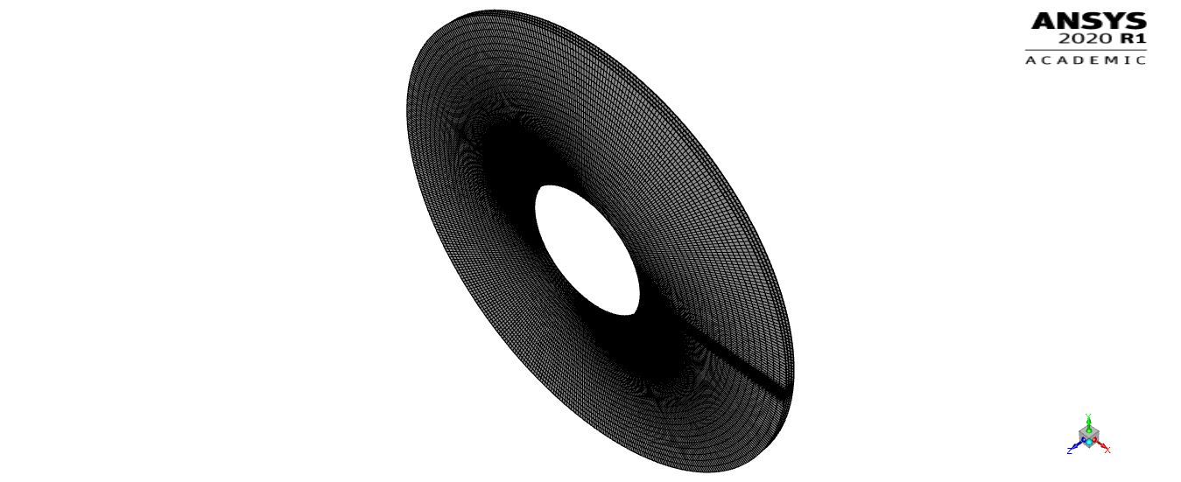
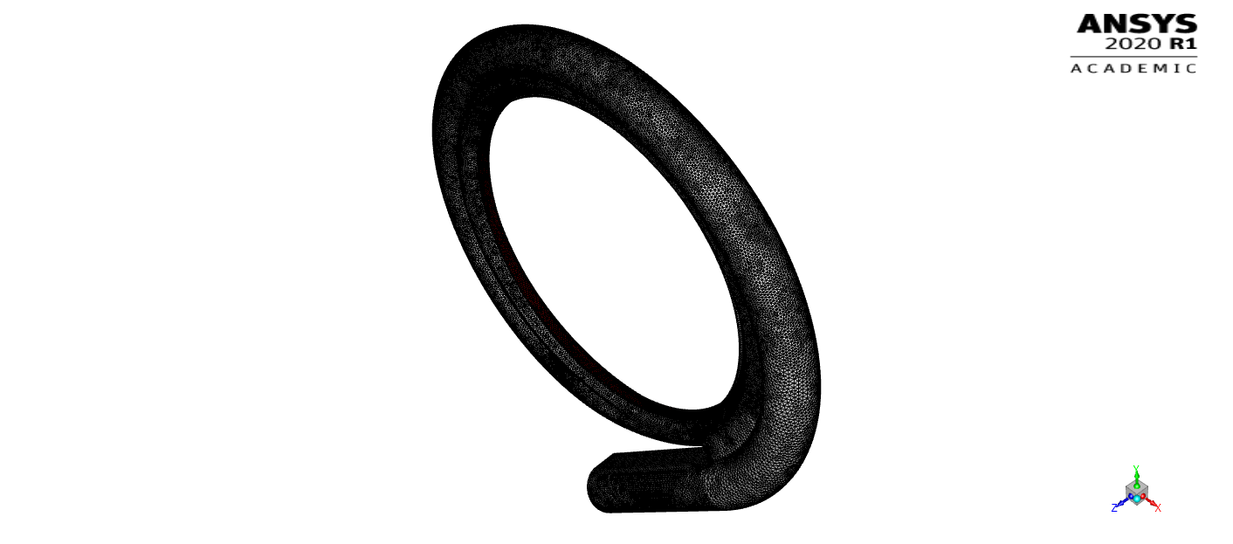
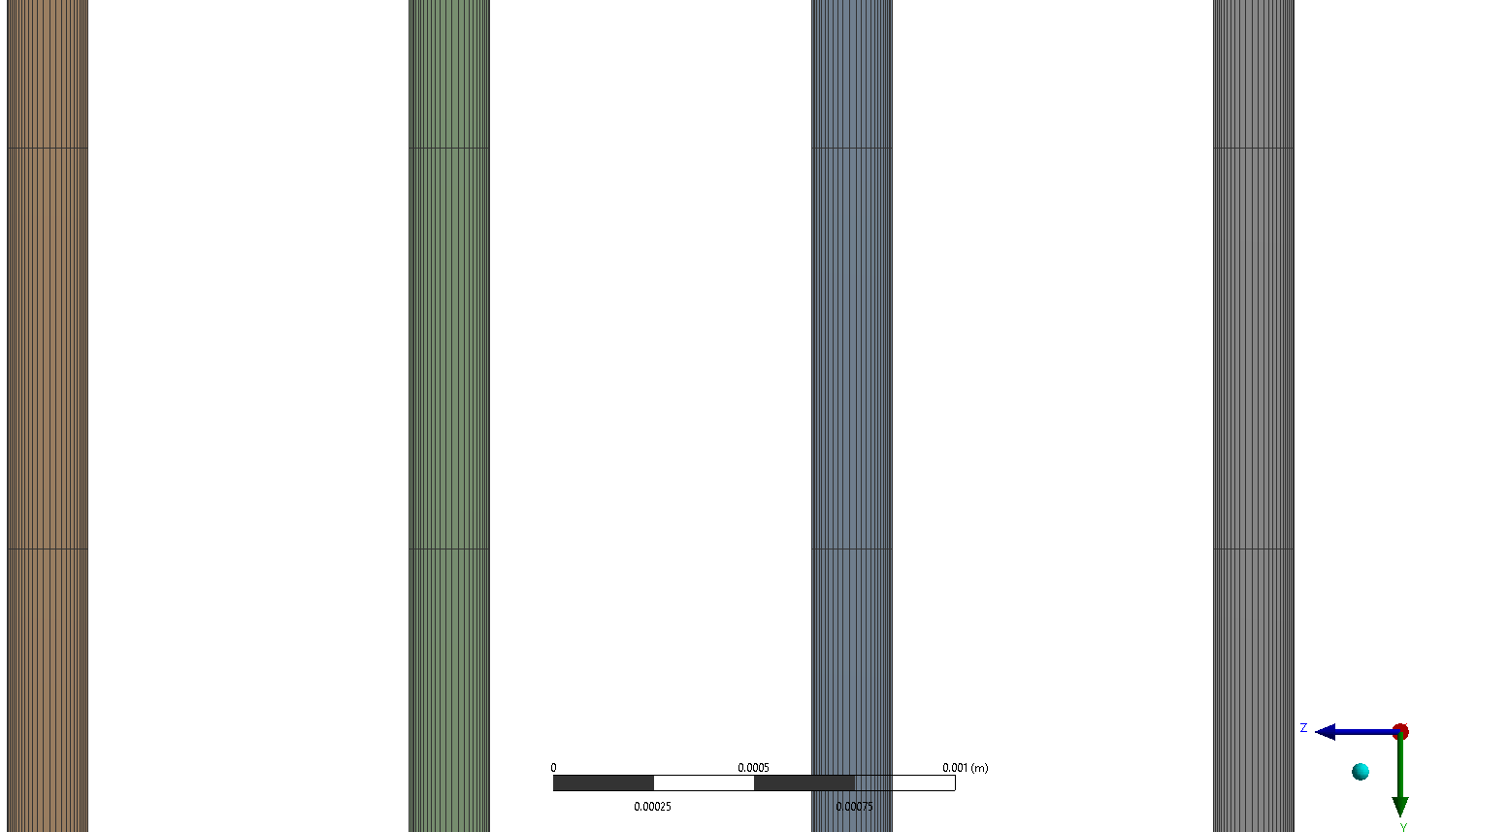
5.1 Methodology – Mesh domain
Outer volute casing
Inner disc region
Notes:
The model was split into 2 parts for CFD. Mesh refinements for the volute casing were mainly focused near the outlet region, where flow variables were expected to change most drastically upon contact with the disc. While for the discs, refinements were mainly focused around increasing mesh number in between the discs. A mesh bias was imposed within the inter-disc region, where the cell size was set to be smaller closer to the disc walls. Cell wall refinement ensures that changes in the flow profile due to the no-slip condition is represented as accurately as possible

Slide 36
5.1 Methodology – Mesh convergence
Evaluate changes in flow field variables over different element numbers.
Azimuthally averaged absolute pressure, velocity angle, and velocity magnitude
Shear stress plots were analysed within Matlab for determining the best fit gradient via principle component analysis (linear regression).
Notes:
A mesh independence study was carried out by evaluating changes in the flow field variables over different element numbers. We tracked changes in the azimuthally averaged absolute pressure, velocity angle, and velocity magnitude at the volute outlet while the azimuthally averaged shear stresses were compared along the discs

Slide 37
5.1 Methodology – Mesh convergence
y⁺ needed to be <30 or >300 for the k-epsilon model
y⁺ ranged between 0.9 – 2.2 in the final simulation
Notes:
The cell size was made smaller near the wall to decrease the first cell y⁺. Elements were further refined until the wall y⁺ was either below 30 or above 300 as required by the k-ε model. The final y⁺ ranged between 0.9 – 2.2 in the simulation, ensuring sufficient resolution of the first cell layer to resolve the flow profile within the viscous sub-layer. The y+ plot above shows the average y+ across along elements in contact with the wall layer, each vertical line represents a wall region. The number of elements can be reduced outside this boundary layer, ensuring convergence with fewer iterations and reduced computational time

Slide 38
5.1 Methodology – Simulation Settings
 | Outer volute casing | Rotating disc region
Turbulent model | Standard k - ε
Wall function | Enhanced
Fluid type | Water – liquid
Wall motion | Stationary | Moving wall
Speed (rad/s) | - | 209.4395
Rotation Axis | - | Z- Axis
Inlet boundary type | Mass flow inlet | Mass flow inlet
Inlet mass flow (kg/s) | 1 | 1
Inlet gauge pressure (Pa) | 100000 | 99394.01091
Inlet turbulent intensity | - | 0.0331
Radial flow component | - | -0.145
Tangential flow component | - | 0.89
Axial flow component | - | 0.00351
Outlet boundary type | Mass flow outlet | Pressure outlet
Outlet mass flow (kg/s) | 1 | -
Outlet gauge pressure (Pa) | - | 0
Outlet turbulent intensity | - | 0.0331
Relaxation factors
Pressure | 0.2 | 0.5
Turbulent kinetic energy | 0.5 | 0.75
Turbulent dissipation rate | 0.5 | 0.75
Notes:
Turbulence was simulated using the standard k-ε model to ensure sufficient resolution of the flow field while keeping the simulation computationally cheap. The volute casing outlet was set as a mass flow outlet so that pressure and velocity variables can freely evolve. Directly superposing the volute outlet profile as the inter-disc inlet proved to be challenging, therefore absolute pressure, velocity magnitude, velocity angle, and velocity components were recorded upon convergence. These variables were averaged and used to set the new inlet

Slide 39
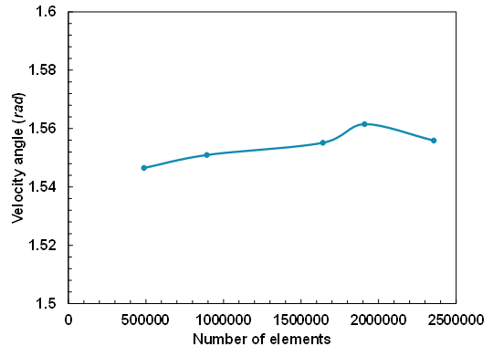
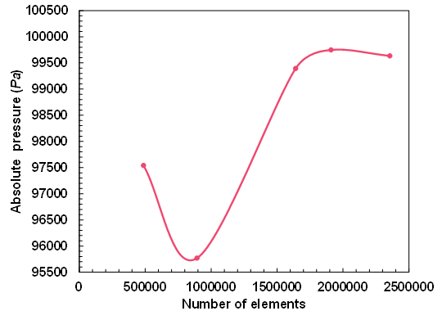
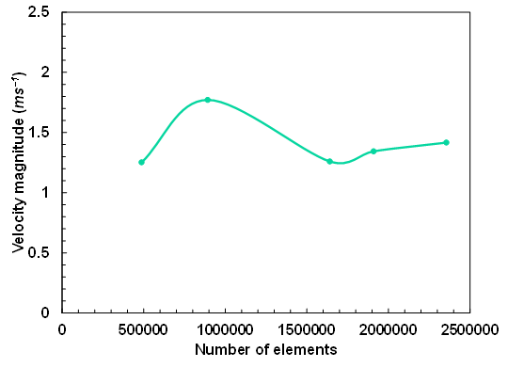
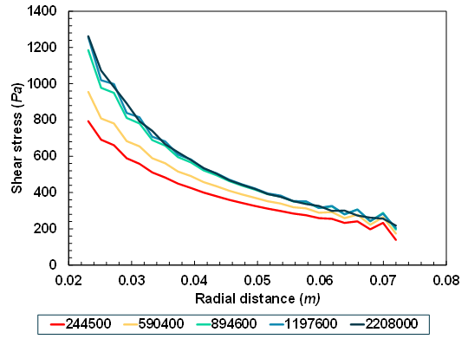
5.2 Results – Mesh convergence analysis
Large deviation in velocity angle, magnitude and pressure at lower mesh resolution
After 1.6 million cells, changes in velocity magnitude were lower than 10% (volute).
More than 890,000 cells, only a 2.25% change in gradient was observed (disc).
Notes:
For the volute casing, convergence analysis shows a large deviation for all three variables at lower mesh resolution. Velocity magnitude observed the largest fluctuation while velocity angle remained approximately the same. Difference in velocity magnitude were all lower than 10% despite much longer computational times after 1.6 million cells. For this reason, 1.6 mil elements were used for the final model. For the inter-disc mesh, 890 thousand elements onwards, the gradient difference only varied by around 2.25% with a 200,000-element increase. At 2.2 million elements, the gradient difference only amounted to a diminishing 0.13% change. For this reason, 1.2 million cells were used for the final simulation

Slide 40
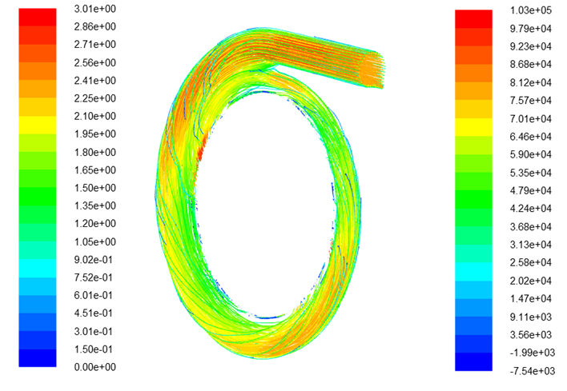

5.2 Results – Performance of volute casing
contours of velocity magnitude and turbulent intensity.
3D pathlines and contours of absolute pressure
Notes:
The main source of losses for Tesla Turbines occurs at the inlet therefore, our volute casing was investigated in detail. We studied the properties of the volute casing using the velocity pathlines, and other parameters such as pressure drop, velocity magnitude and turbulent intensity. We were able to come up with a design which gives us a uniform flow with vortices and a pressure drop across the volute casing of 4.3%. (28s)

Slide 41
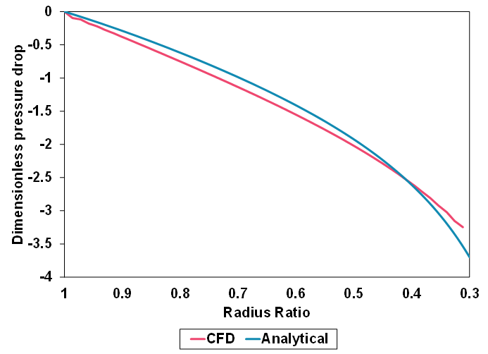
5.2 Results – Performance of disc stack
Dimensionless pressure drop across disc
Notes:
The pressure drop across the rotor discs was evaluated to be similar in shape to that of the numerical model. Some discrepancy in values between the data extracted for CFD and the numerical model may be caused by flaws in the turbulent numerical model, with it’s biggest challenge being flow rotation. (19s)

Slide 42
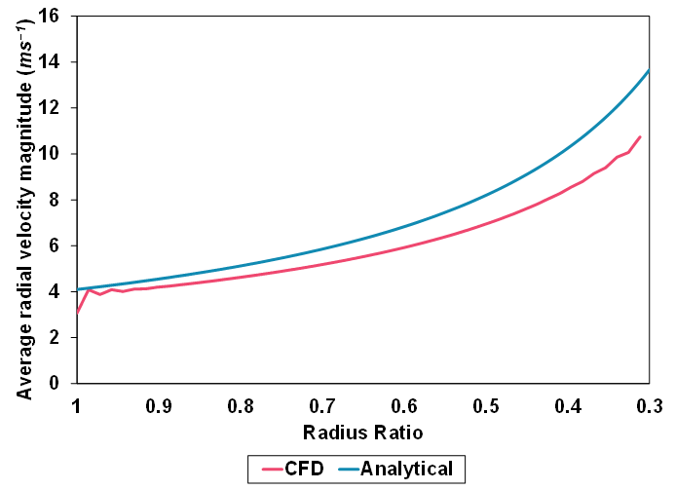
5.2 Results – Performance of disc stack
Variation in relative tangential and radial velocity magnitude in the radial direction between CFD data and analytical
Notes:
The surface-averaged relative tangential and radial velocities was extracted along the plane in the middle of the interdisc gap. Relative tangential velocity for the CFD simulation was observed to be higher than the analytical near the outer radius of the disc. This occurrence corresponds to the lower increase in tangential velocity in the radial direction for the CFD case. The tangential velocity decrease can be explained by considering characteristics of high shear profile, which decreases the fluid velocity more rapidly. The plot on the right shows the radial velocity from the CFD compared with the analytical. For larger radius ratio’s, the results are similar, percentage difference between both cases increase near the outlet. (47)
(47)

Slide 43
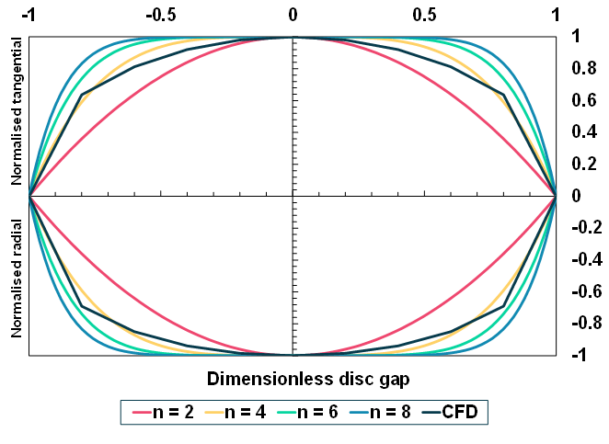
5.2 Results – Performance of disc stack
Normalised radial and tangential velocity in the inter-disc spacing comparing CFD data with analytical
Notes:
The velocity profile in the interdisc region was of interest. The simulated profile does not directly match any of the analytical plots in both the tangential and radial direction. We inferred that due to the continually rotating discs, the flow profile did not fully develop in between. The initial jagged profile may be attributed by insufficient mesh resolution to represent the rapid changes. (26)

Slide 44
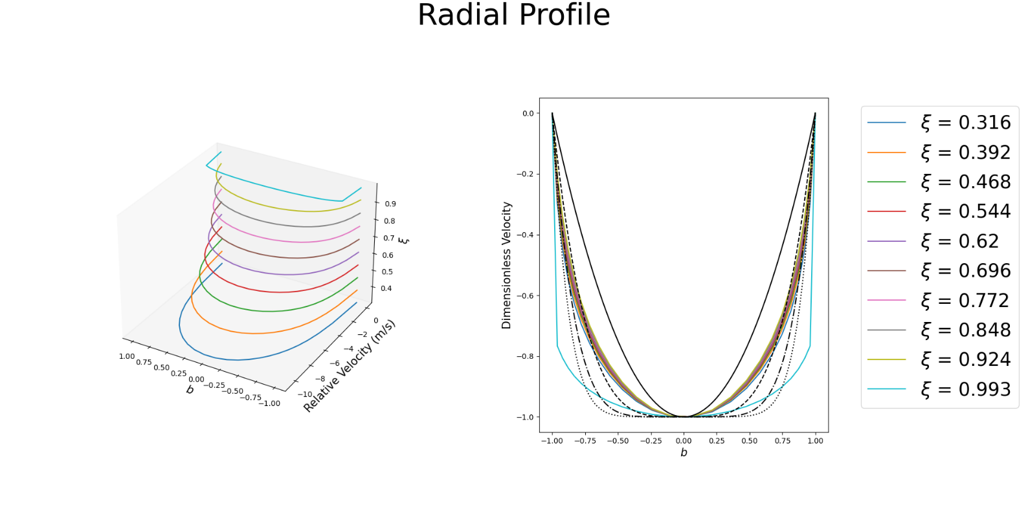
5.2 Results – Performance of disc stack
a)
b)
3D and 2D plots for the dimensionless velocity profiles for different radius ratios
Notes:
We further studied the evolution of the radial velocity profile in the interdisc region using an array of rake lines with different radius ratios. The simulated profile evolves steadily (without reaching a fully developed state as the radial distance decreases towards the analytical profile characterized by $n = 2$ However, at radius ratio of 0.316, the velocity profile shape changes dramatically to resemble that closer to $n = 8$. (27)

Slide 45
5.2 Results – Performance of disc stack
Power extracted from shear stress against RPM of the disc
Notes:
We plotted the power extracted against RPM for the varying theoretical flow profiles, n. The simulated case was capable of higher power output as compared to the analytical for all velocity profiles ( n = 2, 4, 6, 8) which we infer to be due to the higher shear forces in the radial direction. The RPM for our simulation was set to 2000, resulting in a maximum power output of 216 W. (22)

Slide 46
5.2 Results – Performance of disc stack
α comparison for both the analytical and computational case. α < 10 signify laminar flow while 10< α< 20 signify transition flow. Radius ratio of 1 signifies the outer radius of the turbine.
Notes:
The flow regime for corotating discs can best be characterized by the viscogeometric number, $α$. The simulated and analytical flow were laminar near the inlet region from radius ratio of 1 up to approximately 0.45. after which the flow is characterized better as laminar‑unstable (transition zone). Due to the lower radial velocities for the CFD case, the laminar to laminar-unstable transition occurred nearer the outlet than the analytical. Despite the increase in $α$ for both cases, only the analytical achieves turbulent flow at radius ratio of 0.32. Analytical studies only considered laminar flow across the entire domain, leading to an inaccurate representation of the actual flow profile nearing the outlet. This finding corresponds to our initial simulations using a laminar model which did not converge, likely due to the inability to solve for a more complex flow field evolution near the outlet. (53) (4mins)

Slide 47
1. Introduction
Background
Literature Review
Organisation Chart
2. Design Brief
Aims and Objectives
Stakeholder Analysis
Design Specifications
3. Design Process
Design Process
Concept Designs
4. Analytical Model
Goals
Assumptions
Volute Casing Incorporation
Results
Design Variables Optimisation
5. CFD Model
Goals
Methodology
Results
6. Final Design Proposal
Component Selection
Proposed Manufacturing
Materials and Environmental Impact
7. Conclusion
Project Review
Future Work
Notes:
Using all the analysis for the analytical model and CFD simulations, these could inform us into designing our final product. Unfortunately, we could not manufacture our product but we have sufficient ideas and thought-out plans to manufacture this turbine. (13)

Slide 48
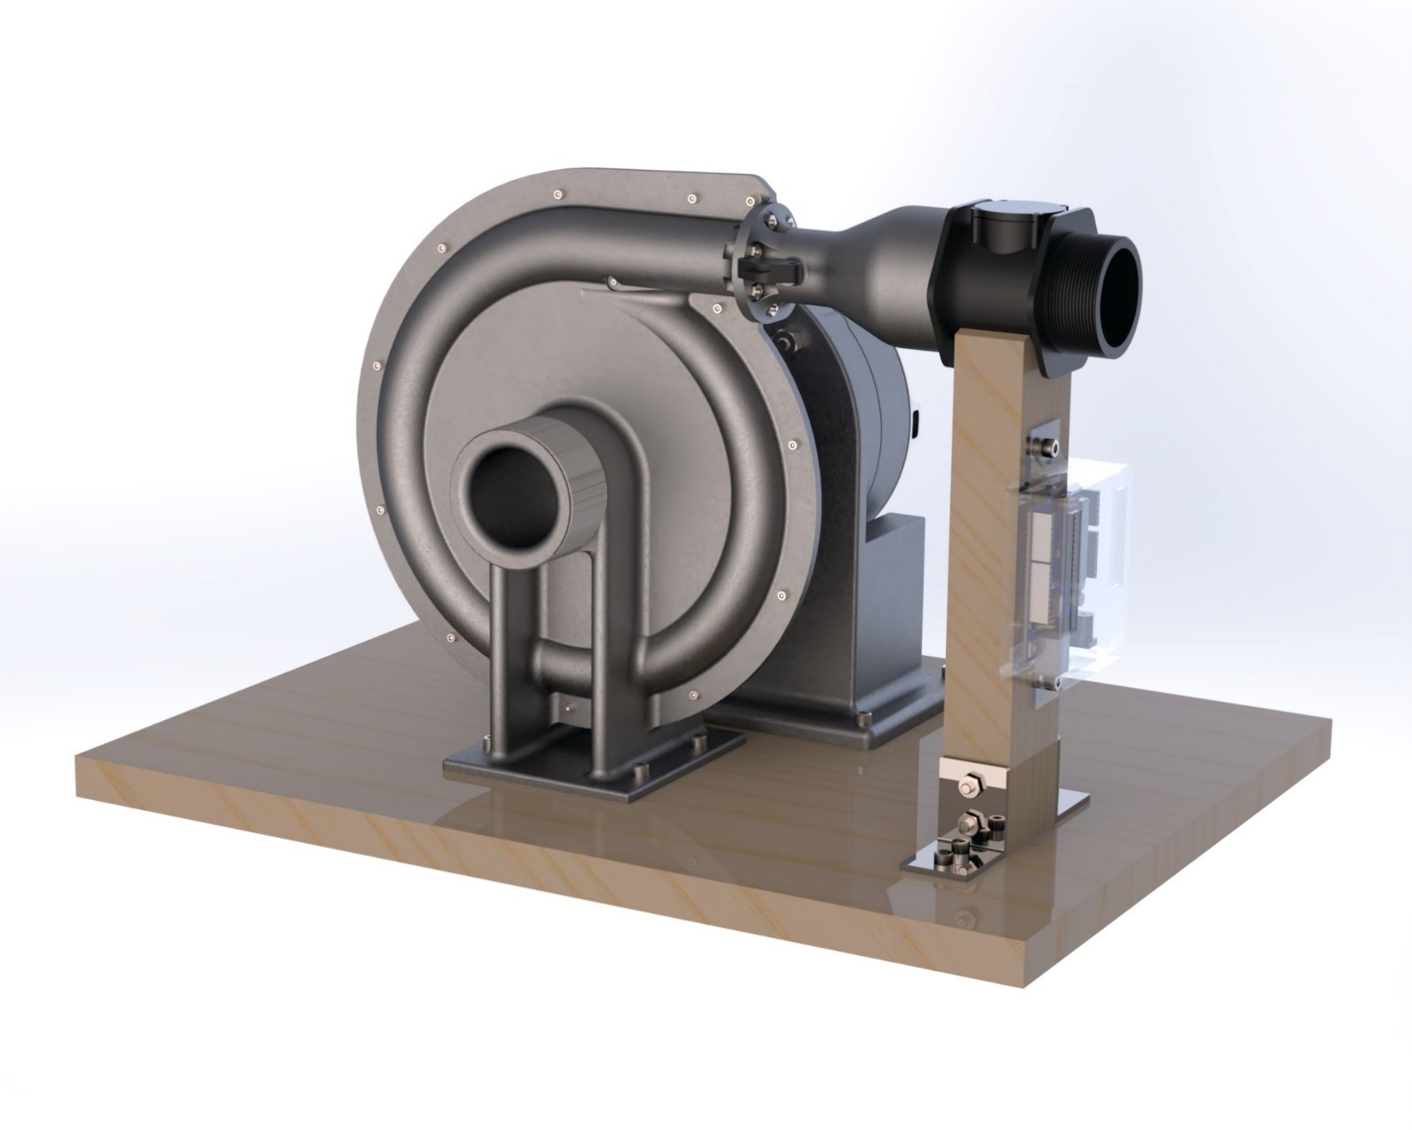
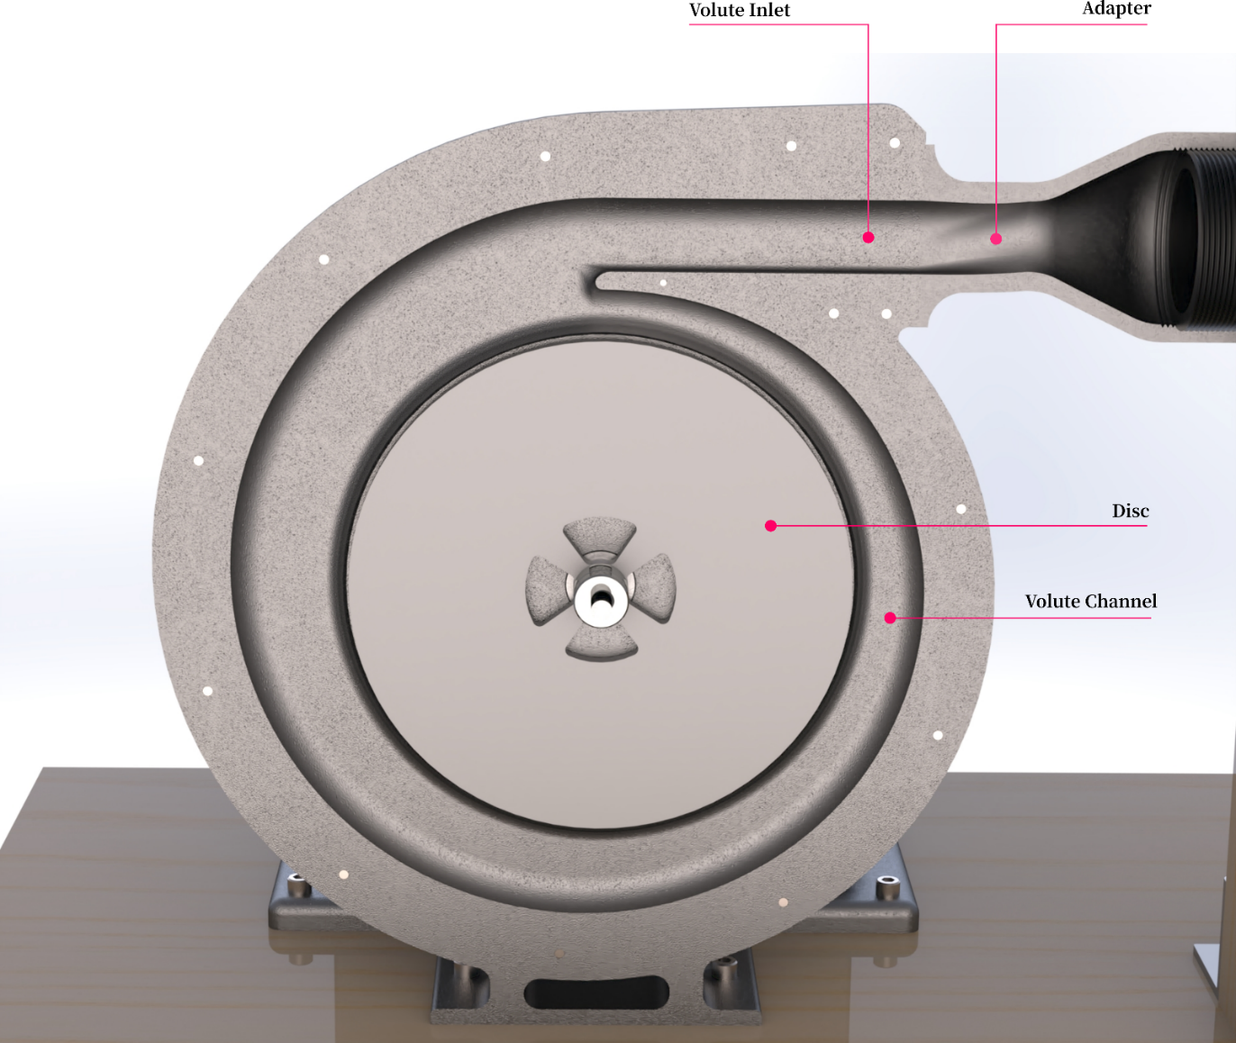
6.1 Component Selection - Inlet
Notes:
Water would enter our turbine through our volute casing inlet. An adapter is to be fixed at the inlet to provide a smooth transition. The image on the left includes an additional flowmeter which would be required for experimental testing. (15)

Slide 49
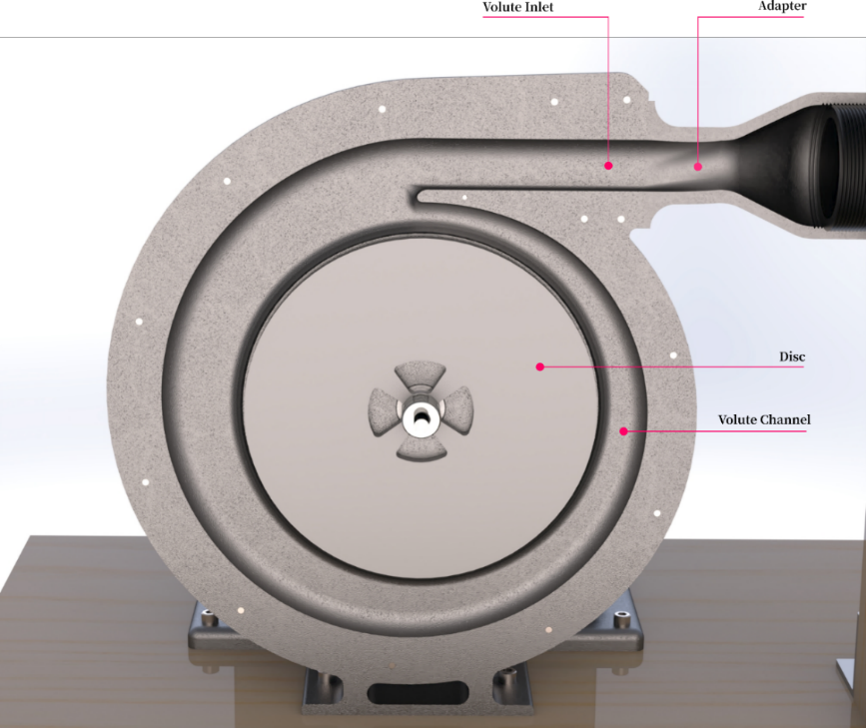
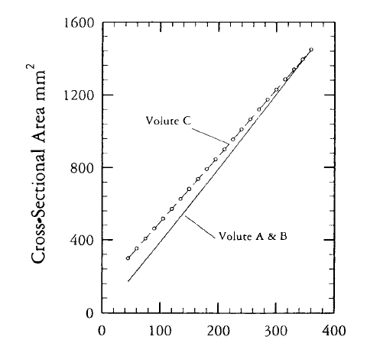
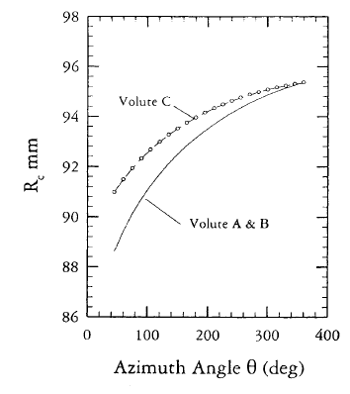


6.1 Component Selection – Casing and Volute Channel
$$\begin{aligned}RC_{θ}=R_{4}C_{θ4}\end{aligned}$$
$$\begin{aligned}R_{c}−r=R_{4}\end{aligned}$$
Chosen volute type: Circular volute with tangential inlet.
More uniform velocity distribution
Decent operating range
Decent peak efficiency
One vortex
Notes:
Here is our circular volute with tangential inlet, which we selected for its ability to provide uniform velocity distribution, decent operating range and peak efficiency. Generally, only one vortex is present in the flow, thus pressure loss can be minimized. (17)

Slide 50

6.1 Component Selection – Disc Inlet and Taper
Volute channel
Volute taper
Disc stack
Notes:
The taper design ended with a tongue section which is mainly responsible for guiding the remaining fluid from the volute into the disc stack. taper results in a smaller flow angle change when channelling fluid into the inter-disc region. With this variation, frictional losses were reduced and flow angle into the discs were more tangential. (20)

Slide 51

6.1 Component Selection – Bearing Hub
Notes:
The bearing hub mainly consists of two conventional ball bearings to ensure the shaft is properly aligned to reduce unnecessary vibrations, circlips to hold the bearings in place and, rubber lip seal to prevent water from entering the bearing hub. (15)

Slide 52


6.1 Component Selection – Disc and Shaft
Notes:
Orifices are introduced to the disc to allow water to escape into the exhaust from the inter-disc gaps. The corners of the orifice are filleted to reduce stress-concentrated regions. Apart from that, the shaft is machined in such a way that the disc stack can be clamped against the extruded platform. We would also have a shaft connector to connect the turbine shaft to the shaft of our alternator. (22)

Slide 53


6.1 Component Selection – Alternator and Outlet
Alternator
Tachometer
Screw thread
Notes:
An alternator would be outsourced from a distributor which would generate power from torque driven by our turbine shaft. Our outlet has a screw thread on the exterior to be fitted with a tube to channel the water out for experimental testing. (13)

Slide 54




6.1 Component Selection – Sensors and Electronics for Experiments
b)
d
Physical Quantity | Sensor | Sensor Model ID.
Inlet absolute pressure (Pa) | Absolute Pressure Sensor | MPX4250AP
Flow rate (m³/s) | Flowmeter | YF-DN50
RPM of turbine | Tachometer / Infrared (IR) Sensor | YF-S201
Notes:
We would have liked to run some experiments for gathering more data for our project. As such we thought of several sensors and electronics that we would have used to run our experiments. The circuitry is relatively simple as there are few components. We would need an absolute pressure sensor and a flowmeter to measure inlet flow conditions and a tachometer to find out our working RPM. Our data acquisition device would be fitted safely on a support and encased in plastic to prevent any damage. (27)

Slide 55


6.1 Component Selection – Final Assembly
Front and side views of renders of the final assembly of the turbine.
Notes:
The images show the final assembly of our turbine with complete mechanical design, ready for experimental testing. Geometrical details are provided in the submitted engineering drawings as they are ready to be used to manufacture the turbine. (15)

Slide 56
6.2 Proposed Manufacturing
Additive Manufacturing
Part | Equipment | Material | Infill | Estimated Time
Front Casing | FDM | ABS | - | -
Rear Casing | FDM | ABS | - | -
Shaft Cover | FDM | ABS | - | -
Alternator Base | FDM | ABS | - | -
Shaft Cap | FDM | ABS | 80% | 30 minutes
Tacho Extension | FDM | ABS | 10% | 1.5 hours
Adapter | FDM | ABS | 90% | 16 hours
Subtractive Manufacturing
Part |  | Quantity | Equipment | Material | Estimated Time
Shaft |  | 1 | Lathe, CNC Mill | Stainless steel rod (20 mm) | 2 hours
Threaded Ring |  | 1 | Bore, CNC Mill | Stainless steel rod (16 mm) | 1 hour
Disc |  | 5 | Waterjet Cutter (MAXIEM 1515) | Stainless steel sheet (0.8 mm) | 2 hours
Spacers |  | 4 | Waterjet Cutter (MAXIEM 1515), Pillar Drill | Stainless steel shims (0.2 mm) | 1 hour
Shaft Connector |  | 1 | Bore, CNC Mill | Stainless steel rod (20 mm) | 2 hours
Main Platform |  | 1 | Pillar drill, Saw | Plank wood (recycled) | 1 hour
Flowmeter Support |  | 1 | Pillar drill, Saw | Wood block (recycled) | 1 hour
Notes:
We received feedback regarding our design upon consultations from Tim Woolman from the EDMC. We are confident of the manufacturing methods that we are proposing which involves a mix of additive and subtractive manufacturing. The volute casing is made up of three parts, the front and rear casings, and the shaft cover that accommodates the bearing hub. They are all printed with FDM technique including the alternator support, shaft cap, tachometer extension and adapter. The shaft, threaded ring and shaft connector will be machined using CNC techniques whereas the disc and spacers would be cut using a water jet cutter. For more information, please view our submitted engineering drawings. (43)

Slide 57
6.3 Materials and Environmental Impact
Requirements:
Capable of being shaped into hollow 3D structure.
Density specification for major components:
Weldability to allow for easy offhand maintenance without the need for complicated processes or complete replacement of parts.
Durability in freshwater and saltwater.
Galling resistance against wear.
Recyclable during end-of-life treatment.
Turbine Material
Component | Material | Manufacturing Method | Estimated Mass, kg | End-of-life Treatment
Casing | Aluminium | Casting | 2.62 | Recycled
Shaft Cover | Aluminium | Casting | 1.42 | Recycled
Shaft Cap | Stainless Steel | Machined from rod | 0.01 | Recycled
Shaft | Stainless Steel 316 | Machined from rod | 0.04 | Recycled
Threaded Ring | Stainless Steel | Machined from rod | 0.01 | Recycled
Disc | Stainless Steel | Stamped | 0.40 | Recycled
Spacers | Stainless Steel | Stamped | Negligible | Recycled
Shaft Connector | Stainless Steel | Machined from rod | 0.14 | Recycled
Subtotal |  |  | 4.65
Externally Sourced
Bearings |  |  | 0.03 | Recycled*
Lip Circlip | Stainless Steel |  | Negligible | Recycled
Lip Seal | - |  | Negligible | Landfill/Combustion
Bearing Circlip | Stainless Steel |  | Negligible | Recycled
Shaft Circlip | Stainless Steel |  | Negligible | Recycled
Alternator | Aluminium Alloy |  | 3.00 | Recycled*
Subtotal |  |  | 3.03
Environmental Impacts during Operation:
Noise (minimal)
Ecology (minimal with mitigation)
Visual (minimal)
Water Quality (negligible)
Air Quality (negligible)
 | Embodied Energy (MJ)
 | Tesla Turbine | Solar Panel Kit | Wind Turbine Kit
Total | 2,094 | 13,150 | 2,290
Notes:
With our finalized design in mind, materials were assigned to the individual components based on their respective requirements. A general list of requirements include:
Shaping capability
Density limit to adhere to weight specification
Weldability, allowing for ad-hoc repairs
Durability in saltwater and freshwater
Recyclability
Using these requirements, the materials are assigned according to the table on the right.
Also shown is the estimated weight and end-of-life treatment for each component.
Using embodied energy values for the respective metals and an estimation for the process energy, the embodied energy of the Tesla Turbine is shown in the table below. It is noted that for the same power rating, the wind turbine and our proposed Tesla Turbine amount to similar embodied energy values whilst solar panels are more energy intensive.

Slide 58
1. Introduction
Background
Literature Review
Organisation Chart
2. Design Brief
Aims and Objectives
Stakeholder Analysis
Design Specifications
3. Design Process
Design Process
Concept Designs
4. Analytical Model
Goals
Assumptions
Volute Casing Incorporation
Results
Design Variables Optimisation
5. CFD Model
Goals
Methodology
Results
6. Final Design Proposal
Component Selection
Proposed Manufacturing
Materials and Environmental Impact
7. Conclusion
Project Review
Future Work

Slide 59
7.1 Conclusion
Goal: To design and optimise a Tesla Turbine for pico hydro applications capable of providing useful and reliable power at an affordable price.
Outcomes:
Section 1 – Introduction
Target market demographic study and comparison against other renewable generation as competitors.
Section 2 – Design Brief
Identification of direct and indirect stakeholders and reflection of their needs and interests in the design specification.
Consideration of other consumer factors leading to the sizing specification.
Section 3 – Design Process
Application of volute casing to Tesla Turbine and performance evaluation.
Section 4,5 – Analytical and CFD Methods
Evaluation of technical performance through analytical and CFD means.
Section 6 – Final Design Description
Assessment of environmental impact in terms of the embodied energy of materials used to produce the Tesla Turbine.
Notes:
In conclusion, we designed our Tesla Turbine to address the challenge of rural electrification in the mountainous regions of Malaysia where other renewables would be infeasible. The Tesla Turbine is to be used in pico hydro applications, capable of providing useful and reliable power at an affordable price.
The first section featured a target market demographic study and evaluation against other competing renewable products.
In the Design Brief, we identified direct and indirect stakeholders, their needs and interests were reflected upon in our design specification with additional consideration of other consumer factors.
The design process featured the investigations made into several concepts for implementation, of which a novel volute casing was chosen to be integrated into the design.
Next, this Tesla Turbine was evaluated through non-physical means through the scope of an analytical model and co-validating CFD simulations.
And finally, we described the final specifications for our Tesla Turbine design and featured a brief environmental impact assessment of the materials and energy used to create a Tesla Turbine.

Slide 60
7.2 Future Work
Design
Modal Analysis
Material Finishing
Detailed Costing Model
Site Details and Detailed Life Cycle Analysis
Numerical Fitting
Notes:
Through the process of designing and evaluating our Tesla Turbine, we also identified several aspects worth further exploration.
Examples of which are:
Further design work to mitigate the potential effect of debris impact.
Modal analysis for identifying resonant frequencies and ensuring fastenings.
A detailed costing model and life cycle analysis with the determination of mass manufacturing processes and specifics.
Clarifications of site detail which allows us to estimate annual energy capture and lifetime generation.
Numerical fitting by application of Fourier analysis on the variation of flow profiles.
And with that, this concludes our Group Design Presentation and
We, of Group Design Project 45, thank you for your attention.

Slide 61
Breakdown of Speakers
Section | Speaker
Introduction | Jerryl
Design Brief | Jerryl
Design Process | Frederick
Analytical Model | Kai Jie and Frederick
CFD Model | Shawn and Nicholas
Final Design Proposal | Frederick and Nicholas
Conclusion | Jerryl

Slide 62

4.5 Design Variables Optimisation
Additional relationships between variables
$$\begin{aligned}w_{d}=\left(n_{d}−2\right)t_{d}+\left(n_{d}−1\right)b\#\end{aligned}$$
$$\begin{aligned}W=w_{d}+2t_{d}+2w_{c}\#\end{aligned}$$
$$\begin{aligned}\begin{aligned}h=\sqrt{\frac{2}{π}}W\end{aligned}\end{aligned}$$
$$\begin{aligned}R_{0}=r_{0}+\frac{W}{2}+t+\sqrt{2Wh−W^{2}}\end{aligned}$$
$$\begin{aligned}r_{i}=0.3r_{0}\end{aligned}$$
Key manipulated variables: disc number ($n_{d}$), disc spacing ($b$), outer radius ($r_{0}$)

